Slide 1



Cognitive Neural Systems and Behaviour
Simon Kelly
Notes:
1
1
1
I’ll describe several studies of perceptual decision making that Redmond O'Connell and I have conducted in Trinity College Dublin and City College, in the past couple of years, and some recent work in my lab in City College on human decision signals that bear on value-based decisions in an imperative selection context.
1
Thanks
So in my talk I’m going to mainly cover some fundamentals of how we examine the operation of the brain through behaviour, and how those behavioural data help us make sense of neural signals, and also how neural signals can sometimes help us make sense of behaviour too.

Slide 2
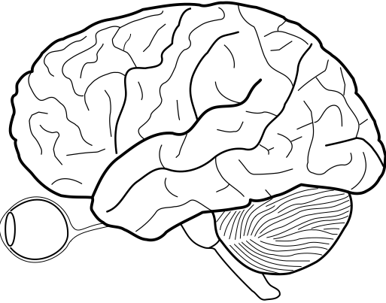
Cognition
Language
Perception
Planning
Decision-making
Reasoning
Attention
Memory
Emotion
Learning
Notes:
So the brain is a complicated system of neural machinery, that, somehow, provides us with the ability to think, to learn and remember, to feel emotions, use language, to perceive objects in our sensory environment and interact with them in a smart way that helps us attain our goals. The study of all of these mental operations is known as cognitive science, and the area of cognitive neuroscience focuses on how neural systems carry out these operations in the brain.
These operations are ultimately the things that constitute intelligence, and understanding how the brain achieves them is vital for building artificial intelligence systems. Reciprocally, the development of artificial intelligence systems provides us with concrete propositions for how the brain COULD BE realising these functions, and gives us solid theories and hypotheses to test.

Slide 3
Cognitive Neuroscience as a system identification problem
INPUT
SYSTEM
OUTPUT
Notes:
But resolving how the brain achieves these functions is a very difficult problem because as we saw, the brain’s complexity already starts at the level of the individual nerve cell and their substructures, never mind the bigger circuits and systems.
As the whole history of neuroscience demonstrates, a lot can be learned by focusing on individual parts of the brain and their neurophysiology just as breaking any problem into smaller parts can help progress, but we also have to understand the operations of the brain at the larger, more global scale of the system, and this can be overwhelming.
In Engineering, when we’re dealing with a system whose operations are unknown and we need to functionally characterise it, we try to do it by presenting carefully chosen inputs to the system and measuring its outputs and by relating the outputs to inputs we determine what operations the system is performing. This is a gross oversimplification, but in much of cognitive neuroscience, that’s kind of what we’re doing with the brain.

Slide 4


Cognitive Neuroscience as a system identification problem
INPUT
Sensory input
OUTPUT
Notes:
The inputs that neuroscientists normally apply are sensory stimuli like sights and sounds, but there’s more than one way to view the output

Slide 5
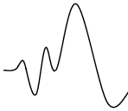
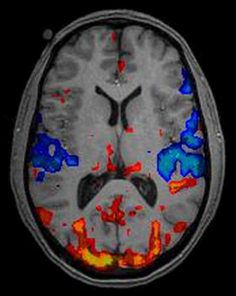
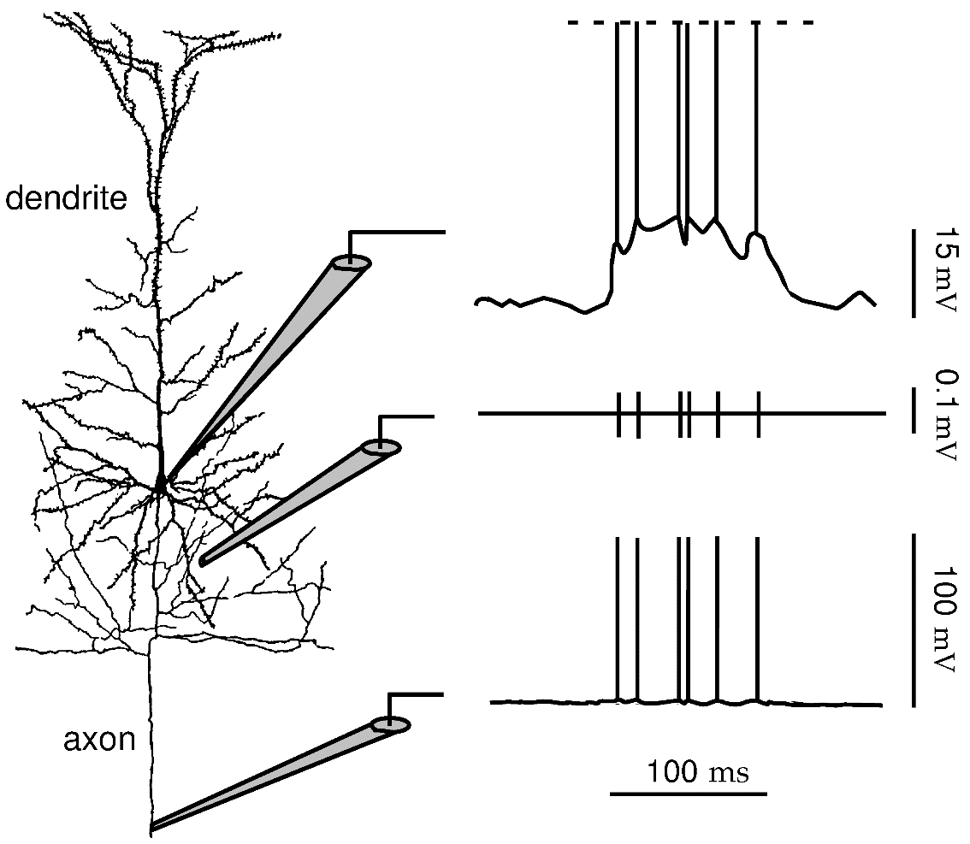
Cognitive Neuroscience as a system identification problem
INPUT
OUTPUT
Sensory input
Brain activity
measurements
Notes:
One way is to view the output as the brain activity measurements you can make using various techniques, whether it’s membrane potential fluctuations and spiking activity of neurons in animals, or noninvasive measures of neurophysiological potentials or functional activation measured from blood flow dynamics
This view provides a powerful way of studying the encoding of sensory information by neural circuits [ and how those representations might be decoded to recover what was presented.]

Slide 6
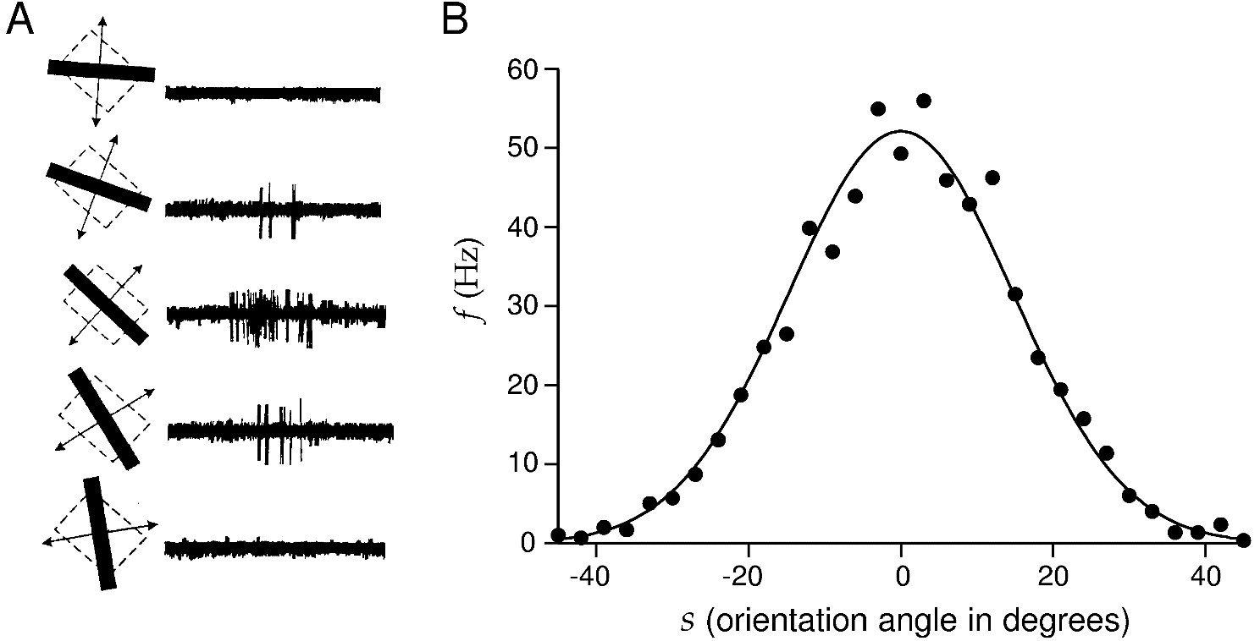
Encoding: Tuning Curve
A tuning curve describes how a neuronal response such as the spike count in a certain post-stimulus window varies as a function of a single stimulus attribute s
Average firing rate can be mathematically described as a function of s: <r>=f(s). (whose functional form depends on neuron and stimulus)
Example: extracellular recordings from monkey V1 neuron as bar passed over receptive field (Hubel & Wiesel)
s_{max} the “preferred orientation”
Notes:
A classic example of the power of this approach is the work of Hubel and Wiesel in and around the 1960s, where they measured spiking activity from cats under anaesthesia, while they presented different visual stimuli to their eyes, and they famously discovered that neurons in low-level visual cortex – the first cortical areas that receive input coming from the retina through the thalamus, have receptive fields, meaning that each one responds to just a restricted area of visual space, and also that they exhibit tuning for different visual features. For example, they varied the orientation of a moving bar within the receptive field of primary visual cortical neurons and saw that the neurons fire a lot for some oris but not for others. They described this in a TUNING CURVE, which,…
This can be captured in a mathematical formula that assumes the curve has a certain shape and specifies the function in terms of a small ste of parameters – in this case a Gaussian captures the tuning well and can be specified by its height rmax, width givn by sigma, and the stimulus feature value where it gives this maximum response – in this case you would called that the PREFERRED ORIENTATION of the neuron.

Slide 7
Cognitive Neuroscience as a system identification problem
INPUT
OUTPUT
Sensory input
Brain activity
measurements
BUT
How do these signals participate in cognition?
Limited insights when using noninvasive measures
Notes:
So this approach is very powerful for understanding the nature of neural representations of things in the world around us.
But in the study of cognition we want to find out how these representations are operated upon to process information in accordance with our goals
And second, this approach is very tricky and quite limited when using noninvasive recordings, where you’re not able to characterise individual neurons
To give an example, I’ll tell a story from my own research

Slide 8
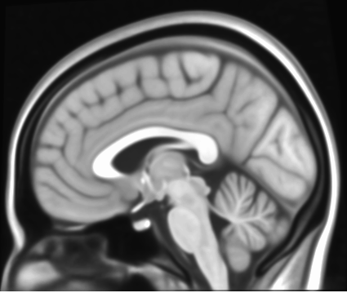
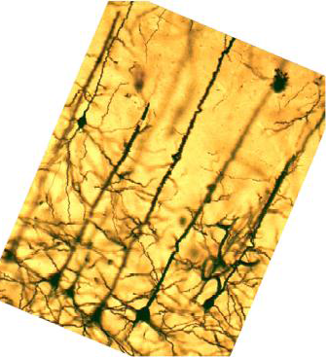
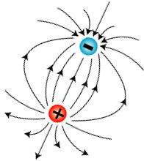

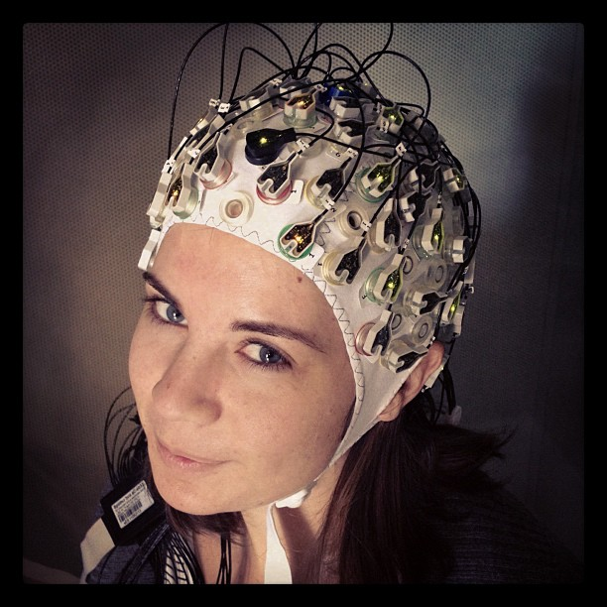
Electroencephalography (EEG)
Synchronously active, aligned pyramidal neurons
Notes:
The technique that I mainly use to measure brain activity is a very old one, and a very crude one, known as ele..
EEG is the noninvasive measurement of the electrical activity of the brain using scalp electrodes. The EEG signal mainly reflects the synchronous activity of pyramidal neurons in cortex that are aligned in parallel, which behaves effectively like an electrical dipole in terms of the potentials measurable at the scalp.

Slide 9
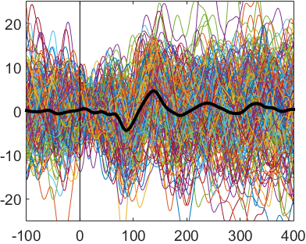
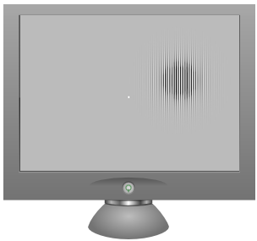
Electroencephalography (EEG)
Synchronously active, aligned pyramidal neurons
Event-related potential (ERP)
μV
Sensory stimulus
Single trials
Average
Time (msec)
Notes:
One of the simplest ways to use EEG to study the brain is to present sensory stimuli to a subject repeatedly and chop out a time segment from the continuous EEG around each repetition and average. The noise level is absolutely huge on a single trial level but if you average enough trials, in this case 200, you can resolve a reliable sequence of deflections that show up on various parts of the scalp over time. And the different successive deflections in this series are often regarded as different components of processing. With enough electrodes you can plot topographies over the scalp.

Slide 10
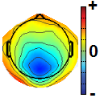
Electroencephalography (EEG)
Synchronously active, aligned pyramidal neurons
Event-related potential (ERP)
μV
Sensory stimulus
Single trials
Average
Time (msec)
Notes:
Now EEG has very poor resolution. You can sample it at high temporal resolution but spatially it’s very crude, only allowing distinguish between frontal versus occipital, left versus right hemisphere… One of the reasons we persist with it is that it is the only way to observe the dynamics of neural activity in the brains of humans, apart from those undergoing surgery for intractable epilepsy.
Probably the most simple and common way to use EEG has been to compare these global electrical responses to different stimuli, or across different conditions or groups of people, including clinical groups.

Slide 11

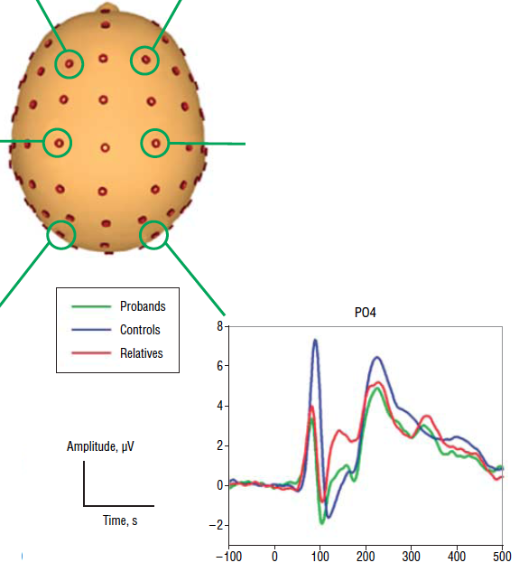
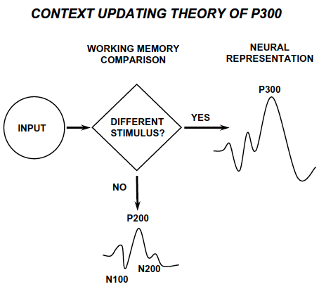
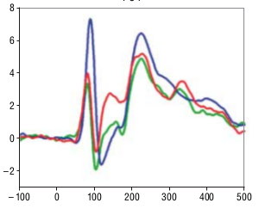
- “direct,” but how interpretable?
Human ERP indices of neural processing: - diagnostic value?
Endophenotypic “P1” deficit in schizophrenia
-a problem with basic sensory processing?
- But WHAT exactly?
Controls
Relatives
Patients
But what IS it??
Yeap, Kelly et al (2006)
Polich (2007)
Time (ms)
Notes:
Since EEG was invented, researchers have hoped that it can provide measures of brain function with diagnostic potential over and above what is obtained from standard behavioral tests used clinically, because, at least relative to neurophyschological pen and paper test scores or symptom evaluations, it could be considered more direct because it is generated by the brain itself.
But this has been very challenging in practice. To give an example, I was involved in a study a few years ago where we recorded evoked potentials to simple visual stimuli like this array of squares up here, in patients with schizophrenia in St. Vincents hospital in Dublin, and saw that compared to controls, the very first electrical deflection in time is dramatically reduced, not just in the patients but also in their first degree relatives, indicating that it could be used as a marker of genetic susceptibility. I was really excited about this particularly because I thought that it might give new insight into how mechanisms of information processing are impaired in schizophrenia, and maybe help explain some of their symptomology, but I was disappointed to find out that no one actually knows what a P1 component is, or what function it serves. Does this difference mean that people with schizophrenia in their family see their sensory world differently than us and if so, how?
To give another example, another component of the ERP that happens later in time after any kind of relevant sensory event is the P300, and this was discovered back in the 60s, but up until recently the dominant accounts of its function were provided in descriptions like this, which is actually just a schematic illustration of one common thing it does experimentally – which is to be bigger for unexpected stimuli – rather than an actual model of what it is or what function it serves.
This is a common problem in ERP research and in this approach in general - We can measure these differences across groups and conditions, but how do we determine their significance or link these signals to tangible functions?

Slide 12
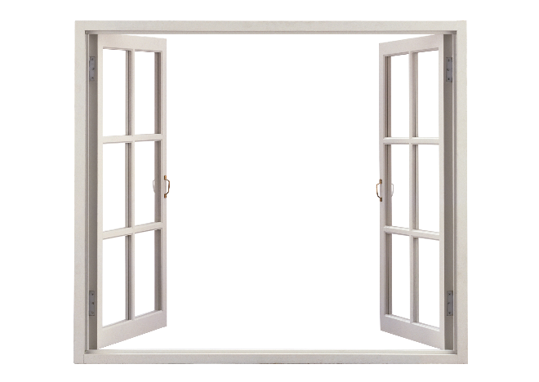


Cognitive Neuroscience as a system identification problem
Brain activity
INPUT
OUTPUT
Sensory stimuli
Behaviour
Right/wrong ?
How fast ?
Task instructions
Notes:
There are two things that can help a lot
One is to recast the main output of the system as the behaviour of the subjects in relation to the stimuli you’ve presented.
After all, the primary function of the brain is not to generate these neural activity patterns – especially not the ones that we can measure globally with noninvasive methods – its primary function is to generate behaviour.

Slide 13
A system identification problem and a design problem
Brain activity
INPUT
OUTPUT
Sensory stimuli
Behaviour
Comp
1
Comp
4
Right/wrong ?
How fast ?
Task instructions
Comp
2
Comp
3
Problem:
Design a task (= stimuli + instructions) that can be broken down into computational building blocks that can be mapped onto measured brain signals.
Notes:
And the second thing is to have good working models of the computations that are required to produce those behaviours, so that we can attempt to link them to the different components of our brain measurements.
So studying the brain processes underlying cognitive functions and linking externally measured signals to those processes, boils down to a difficult design problem: which is to create a task, defined by exactly what stimuli are presented and exactly what the subject has to do with them, in such a way that it can be broken down into computational building blocks that can somehow be mapped to distinct signal components measured noninvasively.
This is a tall order, but
able to manipulate what functions the brain is using while we record from it, and this means designing a task that requires that function in a well-defined way. We need to carefully measure behaviour in that task so we can also know the success and the speed with which that function is performed, and leverage that information in linking a given signal to the function; and finally we need concrete models of how those functions are implemented – what processes and computations they entail – in order to perform that task
In the lab, we measure behavior in a controlled and precise way, so we usually ask subjects to remain still apart from a single movement they can use to indicate what they think they saw or heard, which could be a button press or eye movement for instance. And of course we then need to add task instructions as an input – we have to tell the subject what the rules are.

Slide 14
Overview
Intro to Psychophysics
Signal detection theory
Applying SDT to understand the neural basis of perceptual detection
Perceptual discrimination and its sensory neural correlates
Perceptual decision making: neurally-informed modelling
Attention: Perceptual and neural effects
Behavioural paradigms for other cognitive functions, e.g. memory and learning

Slide 15
Psychophysics
The scientific study of the relationships between
Landmarks:
Wilhelm Wundt (1879): first Experimental Psychology lab
G. T. Fechner (1860): Elements of Psychophysics published
Signal Detection Theory – Green & Swets (1966)
Broader modern usage: the systematic measurement of behaviour in relation to experimental events
Stimuli
Φ
physical domain
Sensations
Ψ
psychological domain
Source: Gescheider GA, Psychophysics: The Fundamentals (1997)
Notes:
Developed within experimental psychology based on the idea that studying sensation can yield insight into the workings of the human mind.
I use many figures in upcoming slides from this book

Slide 16


Sensory Threshold
Herbart (1824): mental events have to be stronger than some critical amount in order to be consciously experienced.
E.H. Weber & G.T. Fechner: can measure that critical amount
Absolute threshold (smallest amount to produce a sensation).
Difference threshold (smallest change Δφ to produce a just noticeable difference (jnd) in the sensation).
No sensation
Sensation
Stimulus energy
Pedestal
Δφ
Nope
Can Notice
Stimulus energy
Notes:
– the sensitivity limits of the human sense organs
- specify the weakest detectable sensations in terms of the stimulus energy necessary to produce them.
An organism’s sensitivity to external stimuli tends to fluctuate from moment to moment, so the threshold should be measured a few times and averaged.
When a stimulus above absolute threshold is applied to the sense organ, the intensity of this stimulus must be increased or decreased by some critical amount before a person is able to report any change in sensation.

Slide 17
Two goals of psychophysics
Descriptive – specification of sensory capacities.
Analytical – the testing of hypotheses about underlying biological mechanisms that determine sensory capacity
Sensory capacities vary systematically across many dimensions other than intensity:
Extension (how big)
Duration (how long exposed)
Quality (e.g. light wavelength (color/hue), sound pitch, orientation of visual or cutaneous stimulus, modality itself)
Notes:
Sometimes description itself is the end goal:
Applications:
Visual displays, street/building lighting, Advertising...
Auditory communications, e.g. cell phones
Media encoding schemes, e.g. mp3…
Clinical – macular degeneration, hearing loss, etc
These go hand in hand.

Slide 18

Example: contrast detection threshold as a function of spatial frequency
Spatial frequency

Slide 19
How sensitive are our senses?
Audition:
Wilska (1935) measured threshold displacement amplitude of the eardrum in the most sensitive range of hearing, 2000-4000Hz
10⁻⁹ cm – less than the diameter of a hydrogen molecule!
Vision:
Hecht, Shlaer and Pirenne (1942) determined the threshold #photons at pupil to evoke sensation under the “best” conditions (dark-adapted for 30 min, 20 deg in periphery, the best size, duration and wavelength)
60% detections at 54-148 photons
After accounting for light reflection, scatter, absorption in ocular media, translates to 5-14 individual photoreceptors in the retina being activated by one photon each!
Notes:
How many photons need to be absorbed by retinal receptors to give rise to the sensation of vision?
Stimulus energy was measured with thermopile at the pupil
Thresholds were measured over a period of months for 7 observers.
What about the threshold number of photons actually observed by the photochemical pigments (rhodopsin) of the? When corrected for 4% of light being reflected back from cornea, 50% or remaining light absorbed by ocular media before retina, and 20% of light at retina absorbed by rhodopsin, the range is 5 to 14 photons!
Because there’s about 500 rods in the 10-min retinal area, that most likely means that 5 to 14 rods must each be activated by absorbing a single quantum of light in order to have the sensation of vision.
the sensitivity of the auditory system approaches a limit imposed by the nature of the stimulus.

Slide 20
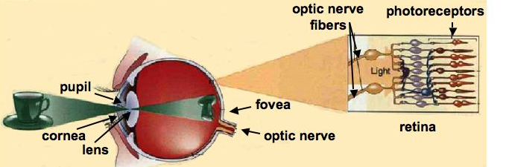
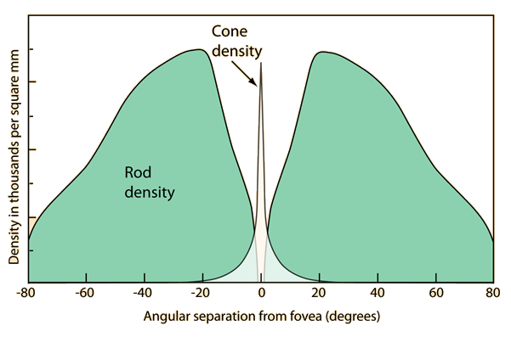
Psychophysical insights into eye physiology
Rods are responsible for scotopic vision (low light 10⁻² – 10⁻⁶ cd/m²)
Cones are responsible for photopic vision (normal light 1 – 10⁶ cd/m², high acuity, color perception)
Notes:
Measuring threshold as a function of other stimulus features provides not just informative characterisations of the sensory system, but can tell you about the internal physiology of sensory organs and neural systems.
The retina is a light-sensitive layer of neurons at the back of the eye.
Photoreceptors (Photosensitive cells) called rods & cones in the retina convert incident light energy into signals that are carried to the brain by the optic nerve. In the middle of the retina is a small dimple called the fovea centralis. It is the center of the eye's sharpest vision and the location of most color perception.
Rods are more numerous than cones, but absent from the very central point of the fovea.
Rods are more sensitive than cones (respond to lower levels of energy), but color is processed entirely by the red, blue and green cones.

Slide 21
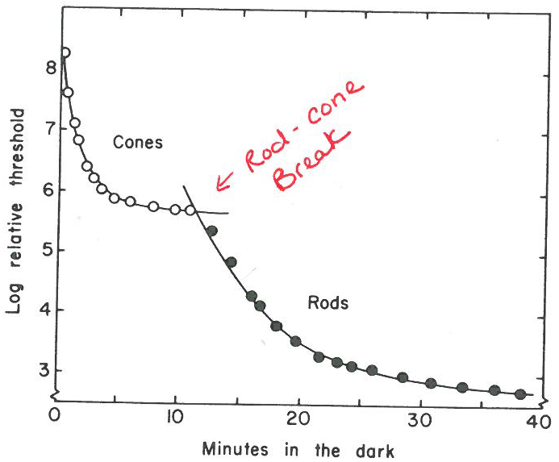
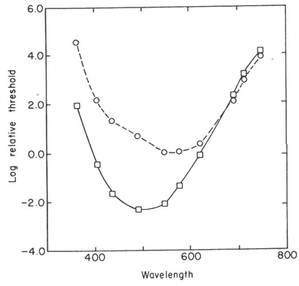
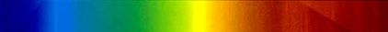
Psychophysical insights into eye physiology
Dark adaptation – recovery of detection threshold after intense light
Spectral sensitivity curves – absolute threshold vs colour (Wald 1945)
Fovea
(cones)
Periphery
(rods)
Rods recover later, and take over ultimate sensitivity
At threshold, colour perceived at fovea but not at periphery
Notes:
You would think that you could only know about things like different classes of photoreceptor from looking on the inside
But…
Exposing the eye to intense light greatly diminishes its absolute sensitivity.
Sensitivity typically doesn’t completely recover until ~1 hour in the dark.
A dark adaptation curve can be traced over time by periodically measuring threshold. The one shown is from a retinal region containing both rods and cones.
Notice it’s biphasic
The joining point is known as the rod-cone break because it arises from intersecting rod and cone recovery curves.
The rods & cones have recovery curves that start at different intensity levels, change at different rates and approach different asymptotes.
Before the break, the absolute threshold of the rods is so high that the adaptation curve is determined completely by the changing sensitivity of the cones. The rod-cone break represents the point where rod sensitivity finally begins to exceed cone sensitivity, and the remainder of the adaptation curve is then determined by the rods.
Also, eye is not equally sensitive to all wavelengths…
Stimulus was 1 deg, 40-msec light of variable wavelength presented to the fovea or 8 deg above (periphery).
We’re less sensitive to the extreme ends of the spectrum.
The most effective wavelength for vision is ~560 nm (yellow) for the fovea and 500 nm (green) for the periphery
The stimulus at threshold appeared to be colored at all wavelengths in fovea, indicating the operation of cones, but appeared achromatic in the periphery, indicating the operation of rods.
At any given extrafoveal location (just outside fovea), you can actually see the difference between the rod and cone thresholds – as you brighten a colored light, you first see that it’s there but can’t tell its color, then after brightening it more, you can see its color.
This is because the color-less rods kick in first, then the color-representing cones.
The photochromatic interval is the difference between rod and cone thresholds

Slide 22
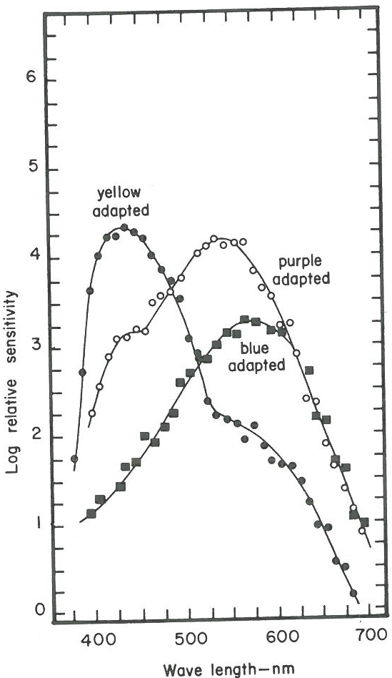
Method of selective adaptation
Can we distinguish different cone types psychophysically?
To determine the sensitivity spectra separately for blue, green and red cones, you can use adaptation.
When exposed to a lot of blue, the threshold for blue is raised, and the blue cones, and to a certain extent the greens, are taken out of the equation.
Thus, the curve for red cones only can be measured.
“sensitivity”
= 1/threshold
Notes:
We can distinguish rods vs cones, but what about…

Slide 23
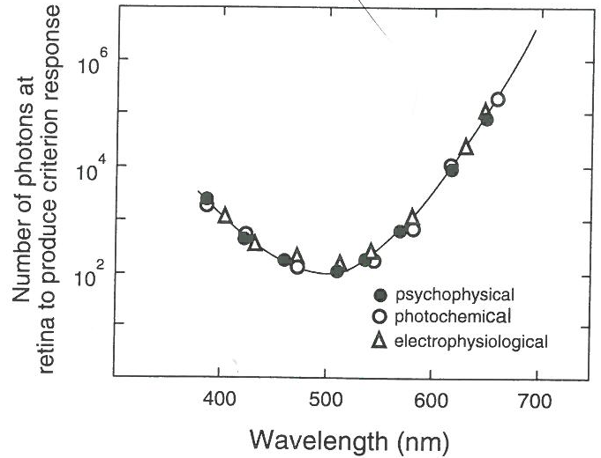
Sensitivity curves: Psychophysical -> Physiological
Same shape -> infer that the spectral sensitivity of the observer is determined by the spectral sensitivity of the neural responses (spike counts) to rods, which in turn is determined by the spectral sensitivity of visual pigment, Rhodopsin, in rods.

Slide 24

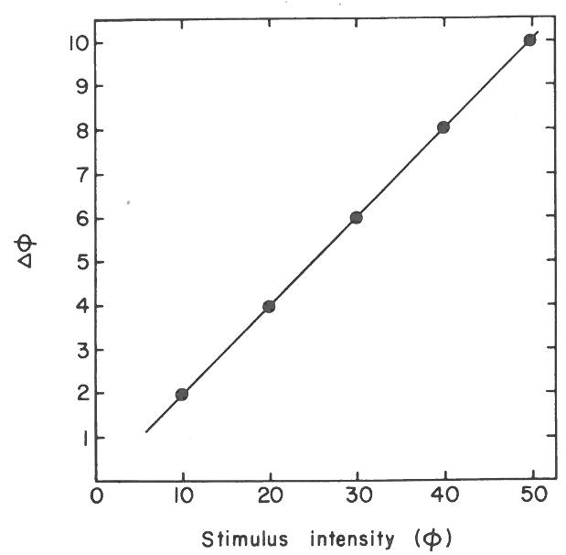
Difference Thresholds: Weber’s Law
Weber discovered that the heavier the weight, the bigger the weight difference required to tell it was heavier.
i.e., difference threshold scales linearly with stimulus intensity.
Applies to wide range of stimuli applied to eye, ear, skin, nose, tongue, …
Weight judgments – which heavier?
or
Notes:
One of the first stimulus critical value functions to be measured was the relation between the difference threshold for intensity and the intensity level of the stimulus
Weber did this with weight judgments – he discovered that the heavier the weight, the bigger the weight difference required for a heavier weight before you could really tell that it was heavier. That is, DL increases with intensity level.
More precisely, the size of the difference threshold scaled linearly with stimulus intensity. Thus, JND can be thought of as a constant fraction of the stimulus intensity.
For weights placed on the skin, this is about 1/30 – called the Weber fraction.
Make sur to say there were several exceptions and qualifications found, but principle applies to a wide range of things

Slide 25
Difference Thresholds: Weber’s Law
Violation of Weber’s law at low intensities
Tweak the model:
where a is a constant that is usually small.
Comes from sensory noise in the sensory organ/brain that exists when the value of φ is zero.
Weight judgments – which heavier?
or

Slide 26
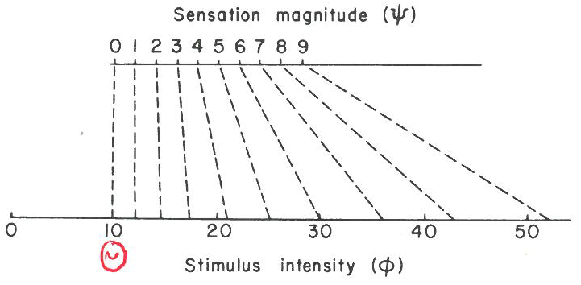
Fechner’s psychophysics
Idea similar to Weber’s law: arithmetic series of mental intensities correspond to a geometric series of physical energies.
Proposed that just noticeable differences (jnd) are equal psychological increments in sensation magnitude, which correspond to values of Δφ on the physical scale that increase with φ.
Doesn’t fully work – e.g. audio stimulus 20 jnd’s above absolute threshold sounds much louder than 2 x 10 jnds
Notes:
Red and blue lights don’t appear equal in brightness when each is brightened by the same number of jnd’s above their respective thresholds
Still, without Fechner we wouldn’t have psychophysics…!

Slide 27
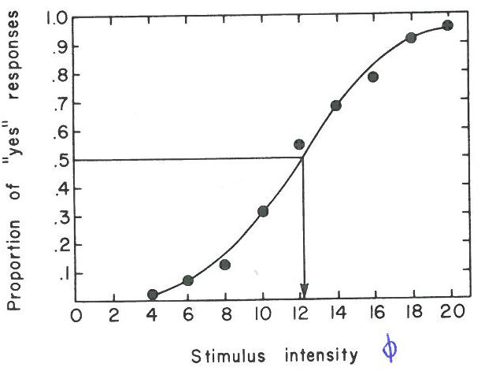
Measuring psychophysical thresholds: Method of Constant Stimuli
Absolute Threshold: Present set of stimulus intensities repeatedly in random order, then plot proportion “yes” response for each level:
Gives Psychometric function
Define threshold as intensity producing e.g. 50% “yes”
Usually a sigmoidal relation that can be fit using cumulative Gaussian function or similar
center μ of Gaussian gives absolute detection threshold
Notes:
The likelihood of stimulus detection will systematically increase across this range of intensity.
9 is good number

Slide 28
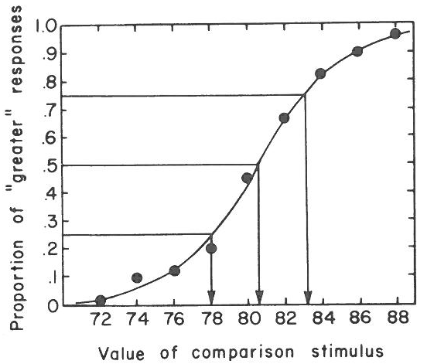
Measuring psychophysical thresholds: Method of Constant Stimuli
Difference Threshold: observer reports which of a pair of stimuli produces a sensation that is greater in magnitude – a standard (St; fixed) vs a comparison (Co; varying)
Again randomize levels, but also order to eliminate space/time error
e.g. Is weight of Co greater or less than St=80g?
Again sigmoidal
Point of subjective equality (PSE) is value of Co that the observer judges to be greater 0.5 of time.
- μ of cumulative Gaussian fit.
Difference Threshold = σ, or Steepness of curve at PSE
Notes:
Often the circumstances dictate which – e.g. for auditory loudness, stimuli are best presented successively. For weights, it’s better to do successive lifts with one hand instead of comparing across left and right hands, because handedness biases your judgments.
In general, you have to watch for both space error and time error
Space error can occur when stimuli are presented at the same time in different locations because the judgments are affected by differences in receptor area as well as the stimulus differences (e.g. tactile intensity comparisons at different fingers, or weights in different hands)
Time error can confound results when St and Co are presented successively.
For example, when Co is presented second, it might always be judged as more intense because the memory of the prior St may have faded, or because attention is “grabbed” by the prior St. OR the second Co stimulus might be always judged as less intense because of a refractory effect, inhibition of return, etc. There are usually several possible sources of systematic error one can think of
One solution to both space error and time error is to counterbalance the spatial location and/or temporal order.
This assumes that when we collapse across all trials, the effects of space and time errors will cancel.

Slide 29
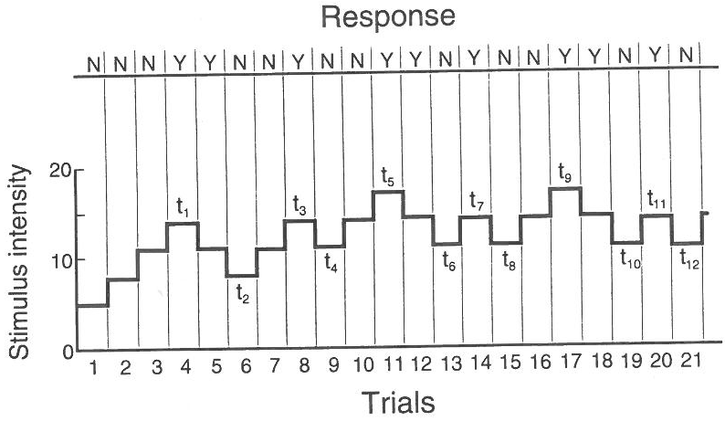
Staircase methods
More efficient
intensity proceeds upward or downward until there is a change in response, and reverses. The threshold is the average of the reversal points.
step size is critical!

Slide 30
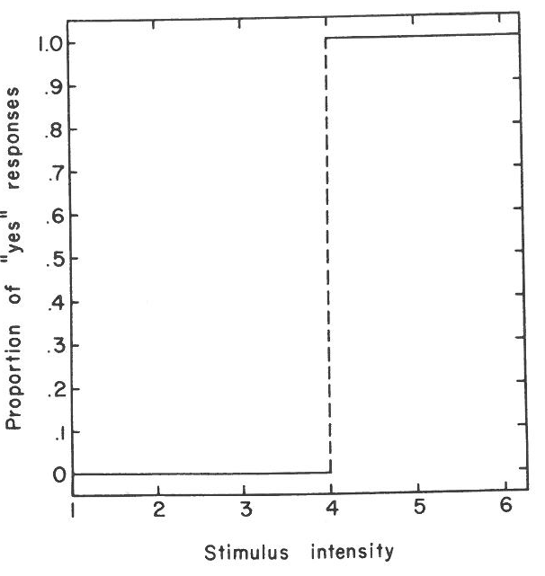
Wait!
Why are psychometric functions not like this?

Slide 31
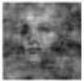
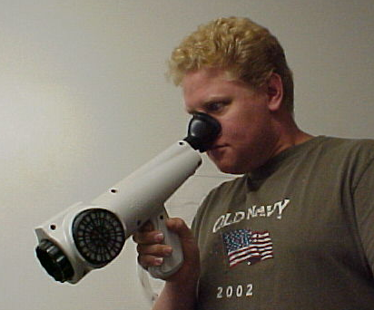
Stimulus Noise
Noise in psychophysical measurements can come from variability or noisiness in the physical stimulus for a given condition
Sometimes this is on purpose and controlled:
(e.g. face detection in phase-scrambled noise)
Sometimes it’s uncontrolled:
(e.g. odorant detection; some escapes!)
Can lead to overestimation of thresholds!
But that’s not all – PMFs are sigmoidal even with zero stimulus variation.
Notes:
Edit: sensory sensitivity underestimated because of stimulus noise (not subject’s fault), which can be controlled (psyphys kernels, powerful tool) or uncontrolled (artifact)
Put up at absolute thresh stuff?

Slide 32
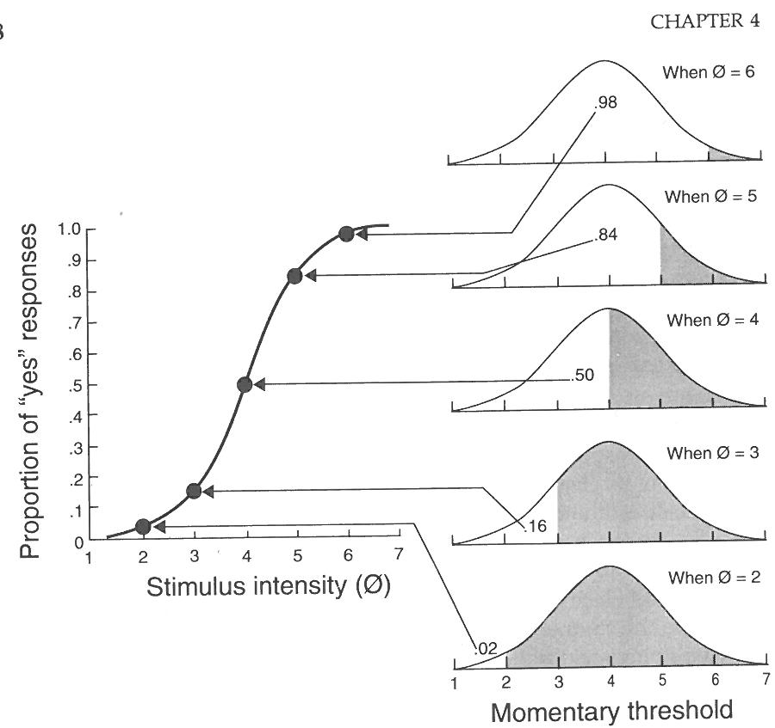
Classical Threshold Theory
Early theorists: neural threshold for sensation – sharp transition from no sensation to sensation at critical amount of neural activity
Sigmoid comes from random variation of this threshold

Slide 33
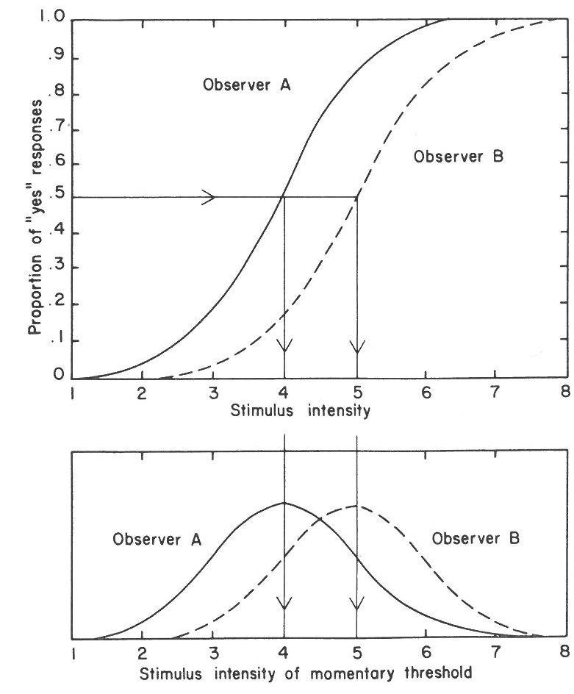
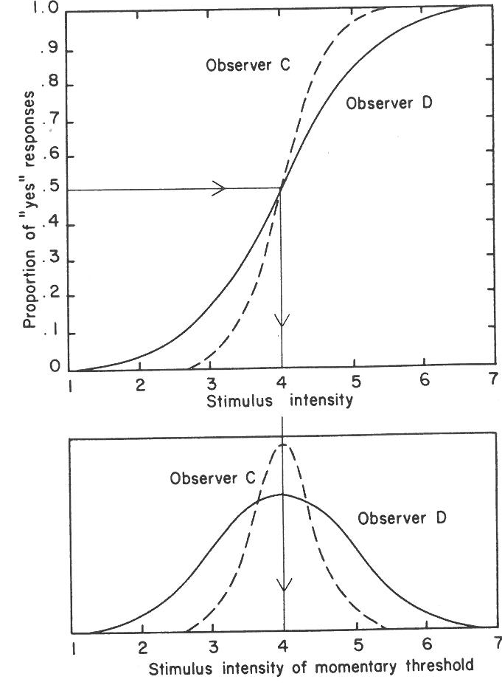
So in this fluctuating thresholds theory, different ogive parameters can be interpreted as differences in the mean and standard deviation of a person’s distribution of momentary thresholds:

Slide 34
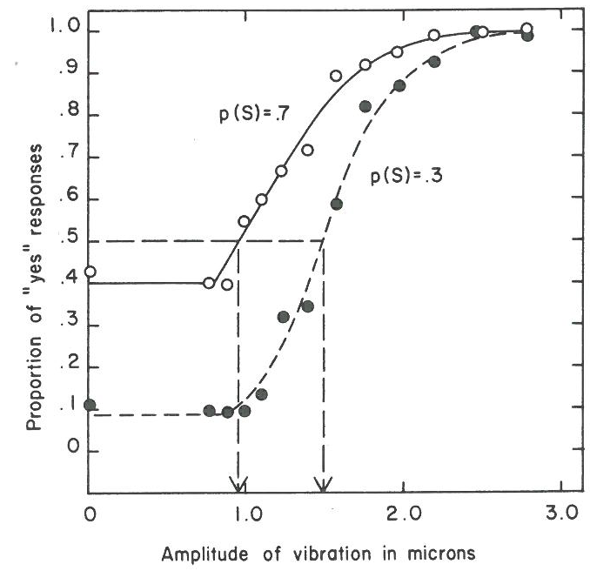
But PMF varies with nonsensory factors!
E.g. Probability of stimulus occurrence, p(S)
“Catch trials” reveal response bias
Training helps only so much
Similar effect of costs and benefits of outcomes
Notes:
It’s apparent that threshold measurement does not consist of an observer simply reporting the presence or absence of sensations.
Early psychophysicists assumed a close correspondence between the verbal reports of an observer and concurrent neural activity in the sensory system caused by stimuli.
They thought that in a well-controlled experiment, the probability of a yes response [p(yes)] was entirely a function of the stimulus and the biological state of the observer.
Recent experiments, however, showed that many nonsensory variables can strongly influence performance in the detection situation, even when well-trained observers are used.

Slide 35
Overview
Intro to Psychophysics
Signal detection theory
Applying SDT to understand the neural basis of perceptual detection
Perceptual discrimination and its sensory neural correlates
Perceptual decision making: neurally-informed modelling
Attention: Perceptual and neural effects
Behavioural paradigms for other cognitive functions, e.g. memory and learning

Slide 36
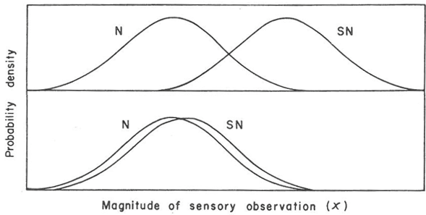
Signal Detection Theory
Tanner & Swets (1954): human detection is same problem as electronic signal-detecting devices hampered by noise
The internally represented observation (x) is what is noisy – not the threshold.
Subject makes a decision from that observation: is it noise alone (N), or signal + noise (SN)? This is done by comparing to a criterion.
Likelihood distributions determined by stimuli and neural encoding noise
Criterion set strategically!
Strong
Weak
Notes:
Tanner & Swets (1954) proposed that the human detection situation might be just like the problem faced by electronic signal-detecting devices that are hampered by noise, which is well understood using concepts of statistical decision theory.
In the detection situation, the observer must first make an observation (x), and then make a decision about the observation – is it due to the signal added to the noise background, or due to noise alone?
The difficulty: because noise is a random variable (and pretty much normally distributed like so many other things in nature), it will be high on some trials by chance and be mistaken for a signal. On other trials, it may be so low that the addition of a signal is mistaken for noise.
The “observation” x could be, for example, the combined spike count from a bunch of neurons in visual cortex during a trial.

Slide 37
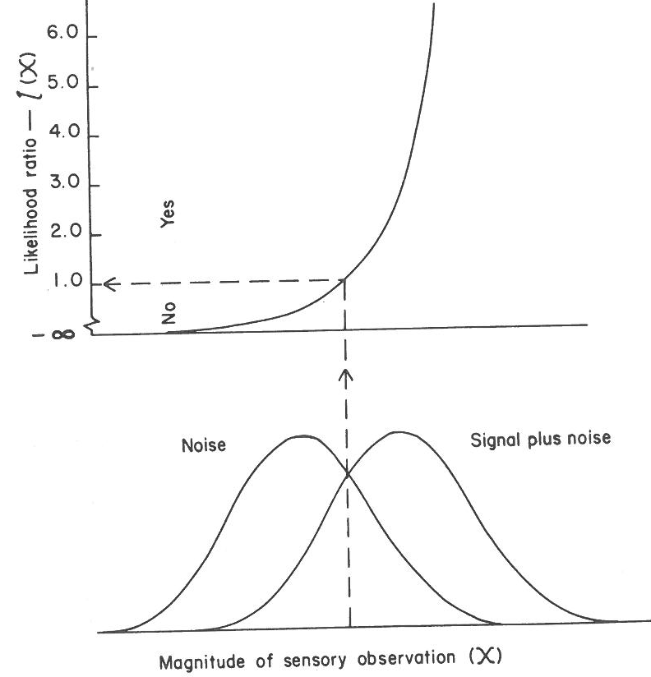
Likelihood Ratio
The SN distribution is always centered on a point to the right of the N distribution for a given stimulus intensity, so l(x) increases monotonically with x.
At some point l(x)=1, because N and SN are equally likely.
For values of x left of this point, N is more likely. For values right of this point, SN is more likely.
All else being equal, this is the best criterion!
Notes:
On any given trial, a sensory observation is made which consists of a random sample from either the N or SN distributions, and the observer has to decide which.
For any given value of observation x, there exists a likelihood ratio, l(x), defined as
This is a sensible quantity on which the observer should base his/her decision – it indexes the relative likelihood of the two alternatives.
x doesn’t even have to be a single parameter – it can be a vector specifying a point among many dimensions, hue, saturation, brightness, etc., since whatever x is, there is a single value for p(x|SN) and a single value for p(x|N).
Stop and ask what your decision rule should be – why is it so absolute, where if it’s greater than a fixed criterion say yes and otherwise say no – why not answer yes just “most” of the time when greater than criterion?

Slide 38
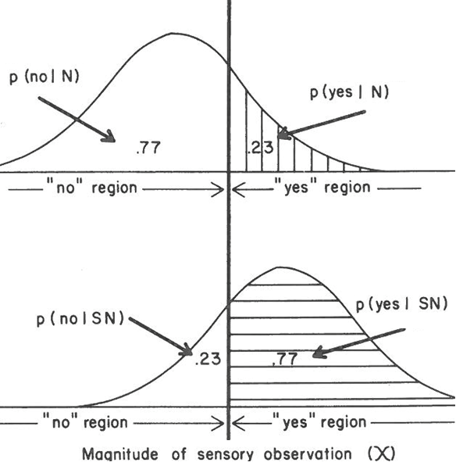
Criterion determines outcomes
Criterion
In detection, 4 classes of trial:
Correct reject
rate
False Alarm
rate
Report
“yes”
Report
“no”
HITS | MISSES
FALSE ALARM | CORRECT REJECTION
Stimulus
present
Hit
rate
Miss
rate
Stimulus
absent
Notes:
A central assumption of TSD is that the observer sets a value of l(x) (and by extension the corresponding value of x) as a cutoff point or criterion (β), and applies a simple decision rule: if l(x) is above β, then choose SN. If below, choose N.
By choosing the right β, the observer can perform optimally. In the simple case with equal p(S) and payoffs, for instance, it’s best to set β=1.0.
The proportions of hits, misses, false alarms and correct rejections can be easily read from the areas under the SN and N distributions to the left and right of the criterion value of x (see fig. next slide).
Note that the larger the overlap between the SN and N distributions, the more the observer will necessarily make mistakes of some kind – whether they are misses or false alarms.
In a typical signal detection experiment for a single stimulus intensity, the stimulus is presented on some trials (SN), and absent on others (N), with randomized order. The observer just reports their judgment of whether a stimulus was present or not.
Hypothetically, if we knew the observer’s observation distributions were as on the last slide, we could predict the observer’s hit rate and false alarm rate from the areas under the prob. distributions.
The power of TSD lies in the fact that you can also do the reverse: The ACTUAL hits, misses, false alarms and correct rejections can be counted in a given experiment, and by assuming that those proportions arise from a pair of overlapping N and SN distributions, you can estimate the amount of overlap and the criterion.
That is, based on the experimentally observed proportions, we specify quantitatively the processes going on inside the observer that are the bases of sensory decision making.

Slide 39
Optimal criterion setting
In the detection situation where the costs and values of the decision outcomes and the probability of signal presence are precisely known, the optimal criterion, in terms of the likelihood ratio, is
This criterion will result in the largest possible winnings in the long run.
Costs are entered as negative numbers.
In practice, observers do exhibit a criterion β that is fairly close to the optimal as long as β_{opt} is not extremely low or extremely high. In other words, people tend to shy away from a strategy of almost always saying yes or almost always saying no.
Notes:
On the left the ratio of prior probability of noise alone versus signal plus noise, on the right it’s the ratio of the relative value of being correct on a target absent trial, versus the relative value of being correct on a target present trial.
To simplify, let’s say the relative value was the same for the two stimulus categories so that last factor is equal to one.
Then what the left part says is that you should respond yes when the likelihood ratio outweighs the prior probability ratio, which boils down to responding with a ‘yes’ when the joint probability of getting that observation value and it being signal + plus noise, is greater than the joint probability of getting that observation value and it being just noise. When the prob of noise is less than the prior prob of signal + noise, this beta optimum is less than one, so going back… it corresponds to setting a threshold on the observation shifted over to the left, which makes you more likely to say ‘yes’ for either stimulus category.

Slide 40
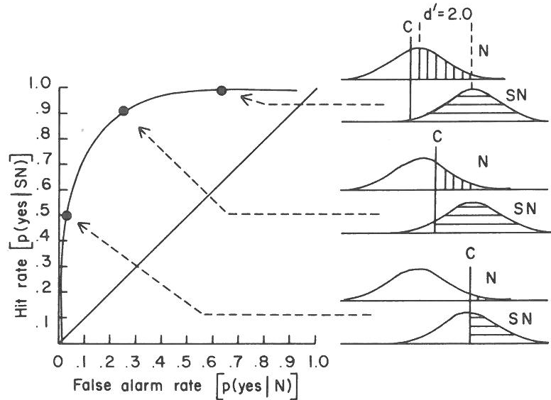
Receiver Operating Characteristic (ROC) curves
Liberal
criterion
High signal strength
Conservative
criterion
Notes:
ROC is swept out with increasing hit rate and fa rate by lowering the criterion from high

Slide 41
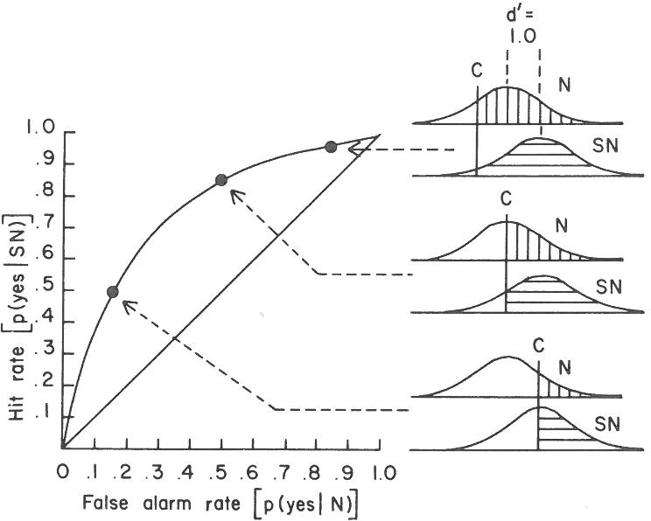
ROC curves
Weak signal

Slide 42
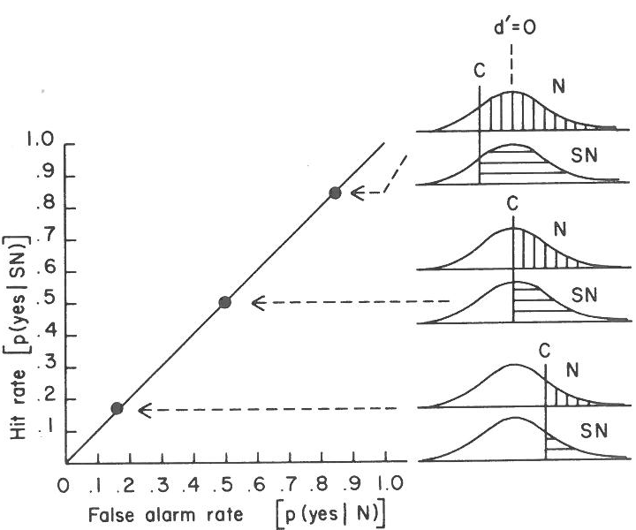
ROC curves
No signal effect

Slide 43
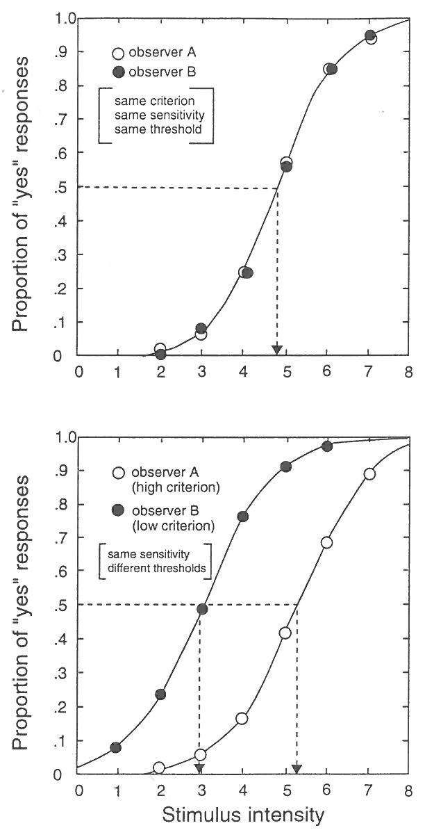
Measuring Sensitivity
In classical psychophysics the measurements of threshold were a function of both stimulus detectability and the observer’s criterion.
Thus, differences in threshold across observers or conditions may be contaminated by changes in criterion, leading to false conclusions about changes in sensitivity.
In the bottom, observer B is equally sensitive to observer A but has a lower criterion, i.e. is more inclined to say “yes” ...
Notes:
Simulate?

Slide 44
Sensitivity: d’
Signal Detection Theory provides a way to independently measure sensitivity and criterion location. It proposes a sensitivity or detectability measure d’ :
where M_{SN} and M_{N} are the means of the SN and N distributions and σ_{N} is the standard deviation of the noise distribution.
Entirely independent of criterion β.
Computed using z-score transformations of observed false alarm and hit rates, p(fa) and p(hit)
First find criterion as a z-score relative to the N and SN distributions:
Zn = norminv(1-p(fa))
Zsn = norminv(1-p(hit))
Then subtract to give d’: d’ = Zn - Zsn

Slide 45
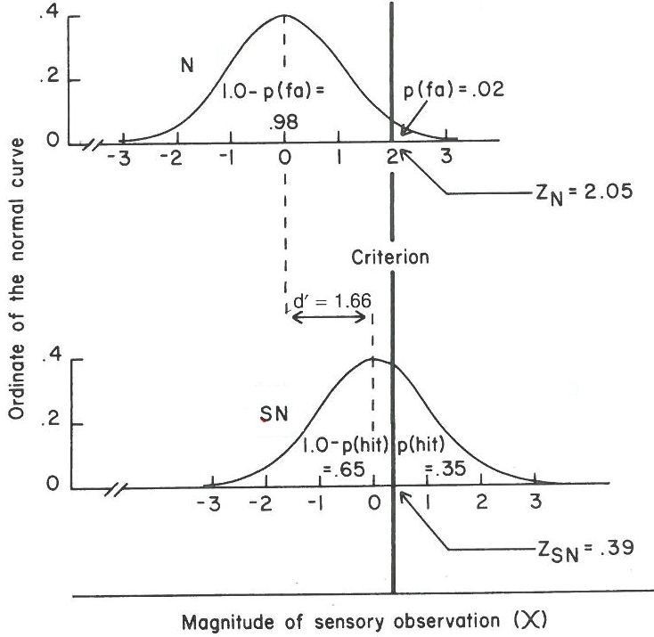

Slide 46
Response Bias
Response bias is the tendency of an observer to set a liberal versus conservative criterion in responding “yes” over “no” due to factors other than signal intensity.
One measure is:
When the false alarm rate and miss rate are equal, the hit rate and correct rejection rate are also equal and the value of C is zero.
C=0 represents no bias – it’s the point where the N and SN distribution cross. The total number of “yes” responses will be the same as the total number of “no” responses.
Negative C reflects a bias toward saying “yes,” and positive C reflects a bias toward saying “no.”
Like d’, C is expressed in standard deviation units (z-score).
Notes:
It’s like the average of the Zs.

Slide 47
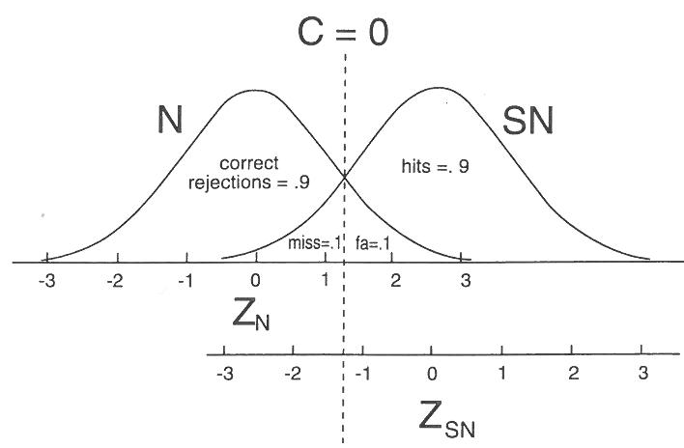
a

Slide 48
Overview
Intro to Psychophysics
Signal detection theory
Applying SDT to understand the neural basis of perceptual detection
Perceptual discrimination and its sensory neural correlates
Perceptual decision making: neurally-informed modelling
Attention: Perceptual and neural effects
Behavioural paradigms for other cognitive functions, e.g. memory and learning

Slide 49
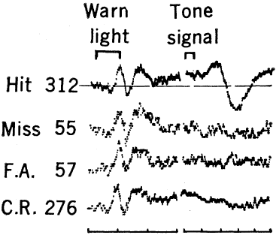
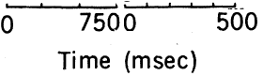
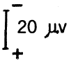
Hillyard et al, Science (1971)
Human EEG, one electrode at vertex
Task: 500 ms after visual warning, tone pip presented or not (50-50), in background noise
Different sound levels in different blocks
Question: Does the Auditory Evoked Potential (AEP) play a role in “determining perceptual reactions?”
Notes:
This is one of the earliest studies to examine the relationships between neural signals and not only the physical stimuli being presented, but also the behavioural responses subjects made on the basis of those stimuli.
Divided trials into the 4 categories of signal detection
Here’s one block for one subject. Can see
Warning light gives same size resp for all cases
But then there’s an early negative component and later positive component that are big for hits and absent for all other categories despite the fact that there was only one difficulty level . So both components have a relationship with perceptual outcome.
2 buttons to press LATER to say yes/no

Slide 50
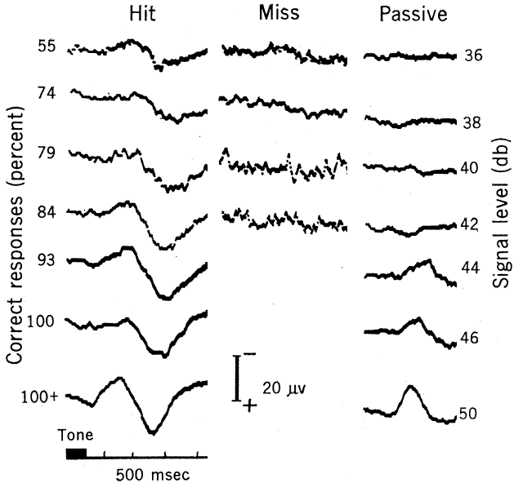
Hillyard et al, Science (1971)
Across blocks with different difficulty
N1 rises with stimulus strength even when passively heard
P300 absent in passive condition
N1
P300

Slide 51
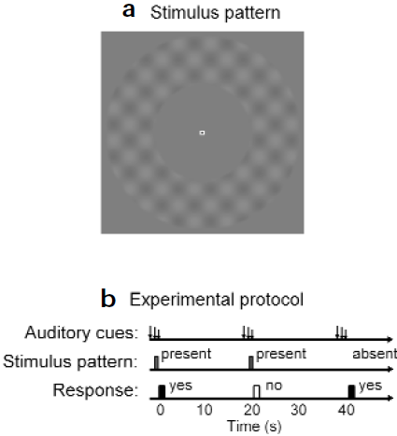
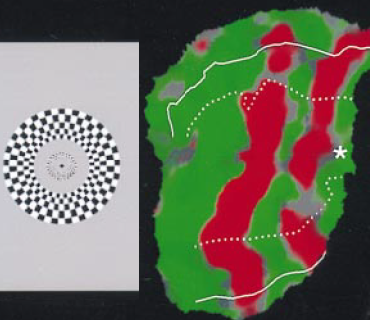
Ress & Heeger, Nat Neurosci (2000, 2003)
fMRI: hemodynamic BOLD response in 3-mm voxels. Focus on areas V1, V2, V3
Notes:
2 buttons to say yes/no
The visual cortex is made up of a hierarchy of distinct areas that each represent the entire visual field but are selective for different features within their receptive fields. V1 is primary vis cx, which feeds V2, which feeds V3 and so on
The neurons in these areas all increase their firing monotonically as a function of contrast.
They are also retinotopically organised. That means that neighboring locations in the cortical area encode information presented in neighboring parts of the visual field, and left maps to right, top maps to the bottom ventral part and bottom maps to top, dorsal part, and so on.
That’s a blown up version of the same part of the posterior brain as on the left… this is how annular patterns show up, as these red stripes, where the green shows voxels that are not activated by the stimulus.
Big magnetic field
protons (hydrogen molecules) in body become aligned to field
RF (radio frequency) coil
radio frequency pulse
knocks protons over
as protons realign with field, they emit energy that coil receives (like an antenna)
Gradient coils
make it possible to encode spatial information
BOLD: amount of oxygenated blood relative to de-ox in an area

Slide 52


V1 activity, and its modulation by stimulus presence, increased with pattern contrast
Greater activation for False alarms than Misses – modulated with perception, not with physical reality!
Ress et al (2000)
Ress & Heeger (2003)
Notes:
Comment on time scale
So the new finding here is that in early vis cx, a signal seems to encode the observation of SDT, that the criterion is set on.
This was interesting because
Note 2003 slightly different stimulus – plaid background or noise always there and either did or did not have grating on top

Slide 53

Vazquez et al., PNAS (2012)
Single-unit spiking activity of neurons in ventral posterior lateral (VPL) nucleus of somatosensory thalamus in monkeys
Vibtrotactile stimulus on fingertip
Contribution to perceptual detection?
Notes:
Contrib of sens thalamus to perceptual detection
Ventral posterior lateral (VPL) nucleus of somatosensory thalamus
Vibtrotactile stimulus on fingertip of monkeys

Slide 54
Recording neuronal responses: Electrophysiology
intracellular – by inserting sharp glass electrode filled with conducting electrolyte into the cell, or “patch clamp”
extracellular – electrode placed near a neuron (usually by ear)
intracellular measures subthreshold membrane potential variations as well as action potentials, while extracellular provides just the action potentials.
Extracellular much easier to do in vivo / awake behaving.
A LOT of ongoing methods innovation
Dayan & Abbot (2001)
Notes:
Membrane pot – resting = -70mV. Action pot positive feedback process – 100mV positive change

Slide 55


Vazquez et al., PNAS (2012)
“Raster” plot – individual spike times
Firing rate during stimulus increased with amplitude of vibrotactile stimulus
(so did spectral component at stimulus frequency)
Notes:
Rasterplot – what is it?
Each row is a single trial, and these are ordered by the strength of the stimulus presented
50% of trials had a stimulus of some magnitude, 50% didn’t
Blue dots are times when hits were made. Red are misses (pressed the ‘no’ button)
Firing rate inc with amplitude of vibrotac stim.

Slide 56



Vazquez et al., PNAS (2012)
Psychometric
Neurometric
Individual thalamic neurons almost as good as the monkey!
…but bore no relationship to perceptual outcome at a given stimulus level!
Notes:
Then they compared the sensitivity with which the monkey’s performance improved as a function of stimulus amplitude – the psychometric function – to an equivalent measure of performance obtained from distinguishing stimulus presence based on the neural response – this is called the neurometric curve – and it’s found for each neuron by finding a criterion that gave best overall %correct when distinguishing firing rates for stimulus present trials from firing rates for stimulus absent trials – we’ll talk more about neurometric functions a little later.
Responses were no smaller for missed stimuli than they were for hits, which really lies at the far end of the spectrum from the results of Ress and Heeger we just looked at – here, the neural responses are tightly coupled to the physical stimulus itself and shows no further covariation at all with the perceptual outcome. In fact, the responses in this active detection task were basically the same as when the same stimuli were presented under a passive condition where the subjects didn’t have to do anything based on the stimulus, as shown on the right
These results suggest that the somatosensory thalamus behaves as a relay station of sensory information to cortex that is insensitive to additional cognitive components. Such cognitive processes are likely to develop and to be integrated with sensory information in circuits downstream from the somatosensory thalamus

Slide 57



De Lafuente et al., PNAS (2006)
Across the sensory-motor pathway, neurons became less coupled to stimuli, and gradually more coupled to perceptual outcome
…but bore no relationship to perceptual outcome at a given stimulus level!
Notes:
In fact, that finding extended earlier findings of the same group using the same task, where they examined how single-neuron spiking responses varied with stimulus strength versus with perceptual outcomes across a whole range of cortical brain areas involved in these tasks from the primary somato area that first processes tactile information all the way to the primary motor area that generates the behavioural response, and the parietal and frontal sensorimotor areas that lie at intermediate stages between the two, and tend to encode some blend of sensory and motor information.
They found that the degree to which neural activity was modulated as a function of the physical stimulus amplitude, represented in the slopes of these lines relating the two, was steepest in early somatosensory cx and gradually became less sensitive in downstream areas
The also measured the covaration with perceptual outcome, by quantifying the accuracy with which you can predict whether the monkey will report that they do or don’t detect the stimulus.
the strength of these covariations between neuronal activity and perceptual judgments progressively increased across cortical areas as the activity is transmitted from the primary somatosensory cortex to the premotor
areas of the frontal lobe. This finding suggests that the
neuronal correlates of subjective sensory experience gradually
build up across somatosensory areas of the parietal lobe and
premotor cortices of the frontal lobe.

Slide 58




Takahashi et al, Science (2016)
Apical amplification hypothesis: dendritic Ca²⁺ activity in Layer-5 cortical pyramidal neurons amplifies the effects of feedback inputs to superficial layers… and gives rise to conscious perception!
Fast-scanning two-photon calcium imaging from apical dendrites of L5 neurons in the C2 barrel column in primary somatosensory cortex (S1)
Genetically-encoded indicator of intracellular calcium – fluoresces green when Ca²⁺ binds to it.
This is captured by a two-photon microscope
Notes:
And to take a final example, of a study using some of the very most modern techniques allowing very fine-grained neural signal analysis
To look at this they measured Ca activity while mice did a whisker movement detection task and examined how that activity varied around the threshold of perception, or around the stimulus intensities where there was the steepest transition from not detecting to detecting the stimulus.
Deflection angle of whisker is proportional to stimulus intensity (stimulated by magnetic coil). The behavioural response that indicated whether the mouse detected the deflection
fast-scanning two-photon Ca2+ imaging from apical dendrites of L5 neurons in the C2 barrel column in primary somatosensory cortex (S1)
genetically encoded fluorescent Ca[2+] indicator

Slide 59



Takahashi et al, Science (2016)
Relationship with perception?
Diverse response types across neurons:
Some strongly distinguished perceptual outcome, others not at all
Ca²⁺ response increased with stimulus strength for some neurons
Decreased for others

Slide 60



Takahashi et al, Science (2016)
Dendritic Ca²⁺ activity causally linked to perceptual detection
Pharmacological manipulation:
Baclofen, a GABA_{B}-receptor agonist, suppresses dendritic Ca²⁺ spikes
Optogenetic Inactivation:
Blue-light on iChLoc suppresses dendritic Ca²⁺ activity
Optogenetic Activation:
Blue-light on ChR2 up-regulates dendritic Ca²⁺ activity
Notes:
To investigate causality, they manipulated
dendritic activity pharmacologically and optogenetically
during the task

Slide 61
Observations
Signal Detection Theory applied:
Across many levels of analysis
whole-brain electrophysiology
individual-area hemodynamics
single cell spiking
calcium signalling in cell substructures
Across many species
Human
Monkey
Mouse
Across many sensory modalities
Auditory
Visual
Somatosensory
Role of cortical feedback
Notes:
The reason Ress findigs were so overwhelmingly in favour of V1 encoding perception rather than sensory reality could be that fMRI would pick up slower anticipatory signals and feedback from higher areas that might not all necessarily translate into spikes

Slide 62
Overview
Intro to Psychophysics
Signal detection theory
Applying SDT to understand the neural basis of perceptual detection
Perceptual discrimination and its sensory neural correlates
Perceptual decision making: neurally-informed modelling
Attention: Perceptual and neural effects
Behavioural paradigms for other cognitive functions, e.g. memory and learning

Slide 63

Discrimination
Discrimination is deciding between a finite set of possible stimulus values.
Motion discrimination (e.g. Britten et al 1992) provides an example:
Task: report whether the net motion is up or down.
Coherence refers to the percentage of dots moving together in one direction, while all other dots reappear at totally random places.
The higher the coherence, the easier the task is.
Notes:
Point here is that the same concepts of SDT can be applied to discrimination as well as detection

Slide 64

Neurometric discrimination
Britten et al (1992) recorded spiking from single neurons in medial temporal area (MT) while monkeys performed motion task.
MT neurons are each tuned to a direction. They presented this preferred direction versus the opposite.
Unpreferred (-)
Preferred (+)
Single neuron-pairs
As good as monkey!

Slide 65


Choice Probability
CP: The trial to trial correlations between the activity of sensory neurons and the decisions reported by subjects
Britten et al (1996) quantified the degree to which a monkey’s choice could be discriminated from the spiking activity of single MT neurons performing the motion task.
Preferred direction chosen
Non-preferred direction chosen

Slide 66

Noise correlations
How can a single neuron have such good discriminating ability, and be significantly correlated with behaviour, when it is only one of so many?
Ans: They are not independent
Ongoing research examining source of noise correlations – e.g. horizontal connectivity or top-down fluctuations?
Nienborg & Cumming (2012)
Notes:
coarse disparity-discrimination
task (Fig. 1) while we recorded extracellularly from disparity-selective
neurons in their visual areas V2.
Psychophysical reverse correlation

Slide 67


Choice Probability
Where does CP come from?
Random noise in sensory neurons which are read from to make decisions?
Top-down signals (like attention) can also mediate choice probability
“Psychophysical kernel”
White-noise stimulus variations
Nienborg Cumming (2009)
Notes:
coarse disparity-discrimination
task (Fig. 1) while we recorded extracellularly from disparity-selective
neurons in their visual areas V2.
Psychophysical reverse correlation

Slide 68

Psychophysical Reverse correlation
Average a stochastically varying stimulus with respect to different perceptual outcomes
Broader applications in e.g. face perception
Notes:
A kiani paper with motion maybe
?

Slide 69
Overview
Intro to Psychophysics
Signal detection theory
Applying SDT to understand the neural basis of perceptual detection
Perceptual discrimination and its sensory neural correlates
Perceptual decision making: neurally-informed modelling
Attention: Perceptual and neural effects
Behavioural paradigms for other cognitive functions, e.g. memory and learning

Slide 70


Immediate sensorimotor decisions
Most tasks in the above involved delayed reports
Allowing immediate decision reports provides richer data
Effects on RT as well as accuracy
Gold & Shadlen (2007)

Slide 71
From Sensation to Action
Sensory
Encoding
Decision
Formation
Action
Planning
Notes:
The classic way to break down sensorimotor decisions is into sensory enc, dec, and action
Now it’s not as simple as a 3-stage system in the brain, but this breakdown has always provided a useful framework for investigating sensorimotor behaviors, which can range from quite dynamic, real-life ones

Slide 72

From Sensation to Action
Sensory
Encoding
Decision
Formation
Action
Planning

Slide 73


From Sensation to Action
Sensory
Encoding
Decision
Formation
Action
Planning
Neuropsych
tests
Notes:
… to quite contrived ones that we use to assess brain function
Even more elaborate cognitive functions require this basic sensorimotor element

Slide 74
Signal Detection Theory
Decision rule = set a criterion C
Encode
Sensory Information
Plan & Execute
Action
“Magnitude of sensory observation”
Provides a quantitative account of behavioral choice – the observers' decision reports.
But what about the TIMING of decisions??
Notes:
74

Slide 75


Linear Approach-to-Threshold model
Encode
Sensory Information
Plan & Execute
Action
A “ballistic” decision signal rises linearly in response to information about a target to a threshold at which a response is initiated.
Rate of linear increase varies from trial to trial with a Gaussian distribution.
Carpenter & Williams(1995), Reddi et al (2003)
Provides a quantitative account of reaction time distributions
Notes:
First consider a typical reaction time distribution in any perceptual task – almost always skewed positively. Why is this, given so many things in the brain can be so nicely approximated by Gaussians…?
Anyway, why does it take us so long to react to the simplest things??
A simple account is provided in a model where a decision variable rises up to a threshold, at a RATE that varies with normal distribution.
The LATER model is one such model (R. Carpenter):
“a decision signal rises linearly in response to information about a target to a threshold at which a response is initiated, at a rate that varies from trial to trial with a Gaussian distribution.” - Reddi et al (2003)
Provides a quantitative account of reaction time distributions through ergodic rate of rise of a “ballistic” decision signal.
75

Slide 76

Drift Diffusion model (for two-alternative decisions)
Encode
Sensory Information
Plan & Execute
Action
Smith & Ratcliff 04
Based on bounded accumulation of noisy sensory evidence
Can capture both timing and accuracy of choices
With additional parameters can capture diverse effects - very versatile!
Notes:
– in the popular sequential sampling framework, first a sensory evidence signal is derived from sensory information which readily distinguishes between the major decision alternatives such as the presence or absence of something, or in this 2-alternative example, the difference between neural signals quantiying rightward motion and leftward motion. For example if you’re deciding between leftward and rightward motion of a random dot stimulus, then the sens ev could be the serived by subtracting the output of neurons that respond to leftward motion from those that respond to rightward motion. But the essential job of this theoretical decision stage is to accumulate that evidence over time until a threshold is reached, which triggers an action. In this 2-alternative decision space, there are two boundaries...
This framework is very powerful because it explains behavioral data on many tasks not only in terms of accuracies for different conditions but also the distribution of reaction times for correct and error trials.
We operate within this framework because it provides a fully mechanistic explanation of what happens from stimulus onset to button click.
76

Slide 77

Drift Diffusion model (for two-alternative decisions)
Consider a decision about noisy visual information

Slide 78

Drift Diffusion model (for two-alternative decisions)
"Decision variable"

Slide 79
Drift Diffusion model (for two-alternative decisions)
Sequentially sampling sensory evidence

Slide 80
Drift Diffusion model (for two-alternative decisions)
Boundary reached – make response

Slide 81
Drift Diffusion model (for two-alternative decisions)
Joint distribution of response time and accuracy

Slide 82


Drift Diffusion model (for two-alternative decisions)
Parameters
a – decision bound
z – Starting point (no bias when z=a/2)
v – evidence accumulation (drift rate)
ndt – non-decision time

Slide 83
Drift Diffusion model (for two-alternative decisions)
Parameters
a – decision bound
z – Starting point (no bias when z=a/2)
v – evidence accumulation (drift rate)
ndt – non-decision time
How cautious? (Speed-accuracy tradeoff)

Slide 84
Drift Diffusion model (for two-alternative decisions)
Parameters
a – decision bound
z – Starting point (no bias when z=a/2)
v – evidence accumulation (drift rate)
ndt – non-decision time
Decision bias, e.g. prior/payoff

Slide 85
Drift Diffusion model (for two-alternative decisions)
Parameters
a – decision bound
z – Starting point (no bias when z=a/2)
v – evidence accumulation (drift rate)
ndt – non-decision time
Expectation of the noisy evidence (i.e. mean)
-> average rate of rise of D.V.

Slide 86
Drift Diffusion model (for two-alternative decisions)
Parameters
a – decision bound
z – Starting point (no bias when z=a/2)
v – evidence accumulation (drift rate)
ndt – non-decision time
Additive delays due to things other than the deliberative decision process

Slide 87
Drift Diffusion model (for two-alternative decisions)
Parameters
a – decision bound
z – Starting point (no bias when z=a/2)
v – evidence accumulation (drift rate)
ndt – non-decision time
Can also add parameters for trial-to-trial variability in:
- starting point (produces fast errors)
- drift rate (produces slow errors)
- nondecision time (shape of RT dist.)

Slide 88

Drift Diffusion model - easily re-cast as a RACE
Gold & Shadlen (2007)

Slide 89

Linear Ballistic Accumulator Model
Encode
Sensory Information
Plan & Execute
Action
Two ballistic, competing accumulators, one for each alternative and the one to first reach response threshold “wins,” i.e. determines the action that is made.
Can account for all major effects the DDM can capture:
How “cautious” responding works, where accuracy is improved at the expense of response speed.
How biases are implemented, due to prior information or reward expectancy.
How errors in some circumstances are faster than correct responses, and in others are slower.
But is simpler and easier to implement
Brown & Heathcote (2008)
Notes:
Ballistic means the decision variable makes a straight shot to bound.
In A. Heathcote’s LBA model (Brown & Heathcote 2008), there are two ballistic, cometing DVs, one for each alternative and the one to first reach response threshold “wins,” i.e. determines the action that is made.
This can account for many more interesting aspects of decision making other than simply the basic shape of an RT distribution:
How “cautious” responding works, where accuracy is improved at the expense of response speed.
How biases are implemented, due to prior information or reward expectancy.
How errors in some circumstances are faster than correct responses, and in others are slower.
All of these things have been accounted for in a more famous, older model called the Drift Diffusion Model.
89

Slide 90



Models of perceptual decision making
Direct
Neurophysiology
Clinical
Investigations
Choice 1
evidence
Psychological
Phenomena
Human
Neuroimaging
Choice 2
Collapsing
Bounds
Model
B
Equally good fit
Model
A
Model
B
Behaviour
Model
A
Model
D
Conflicting Conclusions!
Model
C
Leakage
WHEN and WHY do we employ these strategies ?
Alternative model variants → Equivocal behavioural fit, conflicting interpretations
Notes:
Uses of these models
But there are many as we’ve seen and they don’t always agree so we need NEURAL

Slide 91


Neural correlates of a decision variable
Decision signals in monkey neurophysiology
model
Bound
crossing
apply
predictions
LIP
Decision
Variable
guide model
construction
Ding & Gold (2013)
Evidence
Gold & Shadlen (2007)
Notes:
How do we know the brain uses mechanisms that even remotely resemble this to make decisions?
Well some compelling evidence …
This enables a quite different approach to combining neural data with modeling where models can provide foundational criteria to help identify neural signals in the brain but those signals can also in turn guide the re-consruction of those models so tht they more faithfully reflect the true computational architecture. This means that model validity need not be assumed – they can be tested
Some monkey neurophys work has begun to exploit this approach. What we’d like to do in our lab is apply it to human data. This is a challenge of course because the data are noninvasive and poor resolution, so first question is
91

Slide 92


Combining models and neural measures
Decision signals in monkey neurophysiology
model
Bound
crossing
apply
predictions
LIP
Decision
Variable
guide model
construction
Ding & Gold (2013)
guide model
construction
Gold & Shadlen (2007)
Notes:
How do we know the brain uses mechanisms that even remotely resemble this to make decisions?
Well some compelling evidence …
This enables a quite different approach to combining neural data with modeling where models can provide foundational criteria to help identify neural signals in the brain but those signals can also in turn guide the re-consruction of those models so tht they more faithfully reflect the true computational architecture. This means that model validity need not be assumed – they can be tested
Some monkey neurophys work has begun to exploit this approach. What we’d like to do in our lab is apply it to human data. This is a challenge of course because the data are noninvasive and poor resolution, so first question is
92

Slide 93




EEG studies of perceptual decision making
High vs low coherence discriminant
Gamma activity
Philiastides et al (2014)
Polania et al (2014)
Regression against physical evidence changes
Theta activity
Van Vugt et al (2012)
Wyart & Summerfield (2012)
Notes:
We’re not the only ones to use EEG successfully to examine decision making dynamics,

Slide 94
From Sensation to Action
Sensory
Encoding
Decision
Formation
Action
Planning
Paradigm Design Goal:
trace each information processing stage, in parallel and in isolation
Notes:
but we had a specific goal in our paradigm design: to isolate signals at each processing level

Slide 95


From Sensation to Action
Sensory
Encoding
Decision
Formation
Action
Planning
Task: Detect gradual change in contrast
21 Hz flicker
SSVEP =
k*Contrast
Vanegas et al (2013)
Gradual change eliminates transient sensory response & signal overlap problem

Slide 96


From Sensation to Action
Sensory
Encoding
Decision
Formation
Action
Planning
Task: Detect gradual change in contrast
Respond by unilateral button press
21 Hz flicker
SSVEP =
k*Contrast
Vanegas et al (2013)
Donner et al (2009)
Gradual change eliminates transient sensory response & signal overlap problem
Beta activity decreases with contralateral motor preparation

Slide 97

Decision Signals account for Reaction Time
O’Connell, Dockree & Kelly (2012)
Notes:
of gradual targets led to a 5-fold increase in RT variability relative to discrete target delivery.
Target emergence produced a linear decrease in occipital SSVEP amplitude indicating that this low-level visual signal represents the momentary quantity of perceptual evidence.
The broad-band event-related potential (ERP) trace contained a single centro-parietal component of long duration whose peak latency coincided with response execution. Response-locked averaging indicated that this signal represented the temporal integral of evidence provided by the linearly decreasing SSVEP amplitude signal.
dynamics were consistent with the temporal integration of the sensory evidence signal
97

Slide 98
Decision Signals account for Reaction Time
O’Connell, Dockree & Kelly (2012)
Notes:
of gradual targets led to a 5-fold increase in RT variability relative to discrete target delivery.
Target emergence produced a linear decrease in occipital SSVEP amplitude indicating that this low-level visual signal represents the momentary quantity of perceptual evidence.
The broad-band event-related potential (ERP) trace contained a single centro-parietal component of long duration whose peak latency coincided with response execution. Response-locked averaging indicated that this signal represented the temporal integral of evidence provided by the linearly decreasing SSVEP amplitude signal.
dynamics were consistent with the temporal integration of the sensory evidence signal
98

Slide 99
Decision Signals account for Reaction Time
O’Connell, Dockree & Kelly (2012)
Notes:
of gradual targets led to a 5-fold increase in RT variability relative to discrete target delivery.
Target emergence produced a linear decrease in occipital SSVEP amplitude indicating that this low-level visual signal represents the momentary quantity of perceptual evidence.
The broad-band event-related potential (ERP) trace contained a single centro-parietal component of long duration whose peak latency coincided with response execution. Response-locked averaging indicated that this signal represented the temporal integral of evidence provided by the linearly decreasing SSVEP amplitude signal.
dynamics were consistent with the temporal integration of the sensory evidence signal
99

Slide 100
Decision Signals account for Reaction Time
O’Connell, Dockree & Kelly (2012)
Notes:
of gradual targets led to a 5-fold increase in RT variability relative to discrete target delivery.
Target emergence produced a linear decrease in occipital SSVEP amplitude indicating that this low-level visual signal represents the momentary quantity of perceptual evidence.
The broad-band event-related potential (ERP) trace contained a single centro-parietal component of long duration whose peak latency coincided with response execution. Response-locked averaging indicated that this signal represented the temporal integral of evidence provided by the linearly decreasing SSVEP amplitude signal.
dynamics were consistent with the temporal integration of the sensory evidence signal
100

Slide 101
Decision Signals account for Reaction Time
O’Connell, Dockree & Kelly (2012)
Notes:
of gradual targets led to a 5-fold increase in RT variability relative to discrete target delivery.
Target emergence produced a linear decrease in occipital SSVEP amplitude indicating that this low-level visual signal represents the momentary quantity of perceptual evidence.
The broad-band event-related potential (ERP) trace contained a single centro-parietal component of long duration whose peak latency coincided with response execution. Response-locked averaging indicated that this signal represented the temporal integral of evidence provided by the linearly decreasing SSVEP amplitude signal.
dynamics were consistent with the temporal integration of the sensory evidence signal
101

Slide 102
Decision Signals account for detection accuracy
stimulus contrast
accuracy
reaction time
ROC curves
(hits vs misses)
Left-Motor BETA
Parietal ERP
O’Connell, Dockree & Kelly (2012)

Slide 103
Decision Signals finely trace evidence perturbations
and CPP is independent of motor requirements
O’Connell, Dockree & Kelly (2012)
Notes:
Motor-response specific beta-band activity (16-30Hz) also indexed the accumulation of sensory evidence but only when a button-press response was required.
In keeping with non-human primate work, these results demonstrate that effector-specific regions do accumulate sensory evidence during decision formation in humans but this occurs in tandem with a posterior, domain general accumulator process.
Results: The temporal evolution of the parietal process was highly sensitive to the brief perturbation of sensory evidence irrespective of the requirement of action.
103

Slide 104
Decision Signals finely trace evidence perturbations
and CPP is independent of motor requirements
Responding
Counting
O’Connell, Dockree & Kelly (2012)
Notes:
Motor-response specific beta-band activity (16-30Hz) also indexed the accumulation of sensory evidence but only when a button-press response was required.
In keeping with non-human primate work, these results demonstrate that effector-specific regions do accumulate sensory evidence during decision formation in humans but this occurs in tandem with a posterior, domain general accumulator process.
Results: The temporal evolution of the parietal process was highly sensitive to the brief perturbation of sensory evidence irrespective of the requirement of action.
104

Slide 105

A supramodal signal decision signal
Auditory
intensity
Specific to
RELEVANT
changes
Visual Increases
AND decreases
Auditory frequency
O’Connell, Dockree & Kelly (2012)
Notes:
This condition is very interesting because the sensory evidence runs opposite for the two but the CPP is the same. This dissociation can be brought to bear on several interesting problems. For example, we’re conducting an fMRI study now to localize the CPP, and we’re using this very effect to clearly distinguish between the decision signal and the sensory evidence.
105

Slide 106
A supramodal signal decision signal
Auditory
intensity
Specific to
RELEVANT
changes
Visual Increases
AND decreases
Auditory frequency
O’Connell, Dockree & Kelly (2012)
Notes:
This condition is very interesting because the sensory evidence runs opposite for the two but the CPP is the same. This dissociation can be brought to bear on several interesting problems. For example, we’re conducting an fMRI study now to localize the CPP, and we’re using this very effect to clearly distinguish between the decision signal and the sensory evidence.
106

Slide 107
A supramodal signal decision signal
Auditory
intensity
Specific to
RELEVANT
changes
Visual Increases
AND decreases
Auditory frequency
O’Connell, Dockree & Kelly (2012)
Notes:
This condition is very interesting because the sensory evidence runs opposite for the two but the CPP is the same. This dissociation can be brought to bear on several interesting problems. For example, we’re conducting an fMRI study now to localize the CPP, and we’re using this very effect to clearly distinguish between the decision signal and the sensory evidence.
107

Slide 108
A supramodal signal decision signal
Auditory
intensity
Specific to
RELEVANT
changes
Visual Increases
AND decreases
Auditory frequency
O’Connell, Dockree & Kelly (2012)
Notes:
This condition is very interesting because the sensory evidence runs opposite for the two but the CPP is the same. This dissociation can be brought to bear on several interesting problems. For example, we’re conducting an fMRI study now to localize the CPP, and we’re using this very effect to clearly distinguish between the decision signal and the sensory evidence.
108

Slide 109
Evidence-dependent buildup?
evidence
Decision Variable
Notes:
109
109
109
we had subjects perform a continuous version of the moving dots task, in which coherent motion of one of 4 different coherence levels could occur towards the left or right at intermittent times in an otherwise incoherent stream, and subjects had to click to indicate detection with their corresponding hand. So left hand if motion is left and right for right. And the idea here is that any activity reflecting an evidence-accumulating decision variable, will build more steeply the stronger the evidence.

Slide 110

Evidence-dependent buildup?
evidence
Decision Variable
Continuous Dot-Motion Task
Kelly & O’Connell (2013)
Notes:
110
110
110

Slide 111
Evidence-dependent buildup?
Motion On
Response
ABSTRACT
ACCUMULATOR
MOTOR
PREPARATION
Kelly & O’Connell (2013)
Notes:
111
111
111
We traced the dynamics of two such signals with fine temporal resolution. One was a centro-parietal positivity, which we had previously established builds to a threshold in continuous decision tasks regardless of the sensory modality and even in the absence of any motor response requirement. And here we showed that this abstract accumulator signal built to threshold at a rate proportional to evidence strength.

Slide 112
Evidence-dependent buildup?
Motion On
Response
ABSTRACT
ACCUMULATOR
MOTOR
PREPARATION
Lateralized Readiness Potential
Click Left – Click Right
Kelly & O’Connell (2013)
Notes:
112
112
112
We observed similar dynamics in another signal that was previously well known to reflect relative motor preparation for two alternative actions, called the LRP. This is a slow negative going potential over roughly motor areas contralateral to the impending movement, so when you subtract right from left movements you see a topography like this, where you have a focus of opposite polarity over the two hemispheres. In the waveforms we averaged the contralateral-minus-ipsilateral difference signal for left and right button presses, which is why it goes negative.
But an important point here is that the LRP is motor specific – you’ll only see it if the different decision alternatives are reported through a left vs right limb. And it’s directionally directionally specific – If you don’t collapse across directions as we did here, you can measure not just THAT the subject is accumulating evidence, but also, which alternative they are favouring at any moment in time. This is important for later.

Slide 113

Prior Information in Perceptual Decisions
Time pressure
Perceptual ambiguity
We can expedite decisions when we need to, usually at a cost to accuracy
We can bias our decisions in favour of more probable events
Notes:
113
113
113
More amenable to investigation in humans
113

Slide 114



Prior Information in Perceptual Decisions
Standard models: Speed-accuracy tradeoff
Adjustment of constant bound
Evidence-independent “Urgency”
Bogacz et al (2010)
Hanks et al (2014)
Notes:
114
114
114
More amenable to investigation in humans
114

Slide 115


Prior Information in Perceptual Decisions
Standard models: BIAS
WINNER!
Mulder et al (2012)
How does the brain really make these decisions?
Notes:
115
115
115
More amenable to investigation in humans
115
Std models: idea of selective influence, could be both happening and there are seldom sufficient constraints to tell
Multi-tiered architecture
Can

Slide 116


Joint neural-computational approach
Neural decision signals
Cognitive Process Model
Neurally-informed cognitive model
Convergent evidence for mechanisms and adjustments
Reflects neural implementation at broad systems level
Notes:
116
116
116
More amenable to investigation in humans
116

Slide 117
Prior-informed Motion task
Coherent motion
Color Cue
Dots On, 0%
Fixation
75% 75%
1600 ms
Left / Neutral / Right
764 ms
Coherence Deadline
Easy: 20% 1.6 sec
LoCoh: ~8% 1.6 sec
Deadline: 20% ~0.5 sec
647 ms
50 ms
Manipulated prior information WITHIN blocks
Manipulated temporal/perceptual demands ACROSS blocks
Subjects reported decisions by clicking button with left/right hand

Slide 118

Aggregate behaviour
Deadline fast, LoCoh slow
Deadline and LoCoh Regimes are harder (for different reasons)
Deadline and LoCoh show strong biases due to prior cues
Standard diffusion model can easily fit this. But let's consult neural data...

Slide 119


Neural data -> model
Cue period

Slide 120
Neural data -> model
Priors bias
“Dynamic” urgency
“Static”
urgency
Cue period

Slide 121


Neural data -> model
Response
Evidence
Evidence period

Slide 122

Neural data -> model
Response
Evidence
Evidence period

Slide 123


Neural data -> model
Response
Evidence
Evidence
+
Racing motor DVs
dt
Urgency
RT
Evidence

Slide 124

Neural data -> model
Response
Evidence
Evidence
+
Racing motor DVs
dt
Urgency
RT
Evidence
Evidence

Slide 125
Neural data -> model
Response
Evidence
Constrained
Mean
Start-levels
Evidence
+
Racing motor DVs
dt
Urgency
RT
Evidence
Evidence

Slide 126
Neural data -> model
Response
Evidence
Constrained
Mean
Start-levels
Constrained
Bound
Evidence
+
Racing motor DVs
dt
Urgency
RT
Evidence
Evidence

Slide 127
Neural data -> model
Response
Evidence
Constrained
Mean
Start-levels
Constrained
Mean
Motor-times
Constrained
Bound
Evidence
+
Racing motor DVs
dt
Urgency
RT
Evidence
Evidence

Slide 128
Neural data -> model
Response
Evidence
Constrained
Mean
Start-levels
Constrained
Mean
Motor-times
Constrained
Bound
Evidence
+
Racing motor DVs
dt
Urgency
RT
Evidence
Evidence

Slide 129
Neural data -> model
Response
Evidence
Constrained
Mean
Start-levels
Constrained
Mean
Motor-times
Constrained
Bound
Evidence
+
Racing motor DVs
dt
(CPP)
Urgency
RT
Evidence
Evidence

Slide 130

Neural data -> model
No baseline effects
Early buildup
Evidence
+
Racing motor DVs
dt
(CPP)
Urgency
RT
Evidence

Slide 131



A
REAL DATA
B
NI model Simulated
C
DDM Simulated
Evidence
Trial end
Proportion of trials
How well does the Neurally-informed model fit the behavioural data?
Accuracy
chance

Slide 132
A
REAL DATA
B
NI model Simulated
C
DDM Simulated
Evidence
Trial end
Proportion of trials
Accuracy
chance

Slide 133

Neurally-informed Model vs DDM

Slide 134

Real Decision Signals
Evidence
RT

Slide 135

Simulated Decision Signals
Evidence
RT

Slide 136







Applications to studies with clinical relevance
Hit rate RT (ms)
Standard DDM says older people have higher bound and higher drift rate
Older slightly better
Contrast change
detection
Constrained model reveals difference in drift rate variability
… and Alpha-band fluctuations concur!
But neural decision signals indicate there is no difference in either bound or drift rate!
McGovern et al, Nature Human Behaviour (2018)
Notes:
Mention that different pattern of effects were seen in a motion discr task, but similar outcome whereby unconstrained model showed bound diff, but CPP/beta didn’t, and constrained model revealed novel effects: again lower drift rate var in old, but also lower mean drift rate.

Slide 137
Overview
Intro to Psychophysics
Signal detection theory
Applying SDT to understand the neural basis of perceptual detection
Perceptual discrimination and its sensory neural correlates
Perceptual decision making: neurally-informed modelling
Attention: Perceptual and neural effects
Behavioural paradigms for other cognitive functions, e.g. memory and learning

Slide 138

Attention
Improvement of perceptual processing and action selection by prioritising based on prior knowledge or salience, or by being more alert
Notes:
Lots of info, bombarded
If finding friend, need to Selectively process features we know about them – know wearing red, taller than most people, arriving on the Southbound train. This can be at the expense of other things – so intent on friend we might miss other events on the platform that are right in front of us.
It’s about allocating limited processing resources.

Slide 139
Attention Paradigms
Spatial cueing
Selective attention – preferential processing of certain sensory information deemed to be relevant or important. The info is “relevant” either because it’s associated with your current goals (Endogenous attention) or because it’s physically salient, e.g., loud or bright, or sudden (exogenous attention). Selection can be:
SPATIAL
FEATURE-BASED
Vigilant attention - the ability to maintain a mindful goal-directed focus in contexts whose repetitive, nonarousing qualities provide little external stimulation.
+>
Visual search
+
Notes:
These would be typical, representative, but there are many

Slide 140


The Locus of Selection – early or late?
e.g. Treisman (1960):
Cocktail Party
Unattended information can be hugely attenuated but not gated out completely.
So are the sensory representations themselves modulated?
Notes:
Things like your name and “help!” can get through even when attending intently to someone

Slide 141




Attentional Modulation of Sensory Neural Responses
Intracranial single-unit
Scalp event-related potential (ERP)
Mangun et al (1993)
(1985)
Notes:
So how do we know that sensory information is being tampered with in its early stages of representation? By measuring neural activity directly and watching it change with attention.
Here are just two examples, drawn from two experimental techniques that I’ve used. Over here is the classic study of Moran and Desimone where you can see that under 2 conditions where you have the exact same two stimuli appearing in a V4 neuron’s RF – one usually effective in driving the neuron, the other not, you can measure very different firing rates depending on which is attended, almost as if the neuron doesn’t even see the unattended item.
Here’s an example from the human event-related potential approach. In this technique an array of electrodes are attached to the scalp of human participants non-invasively, and conditions are repeated at least 100 times so that snippets of scalp data in a certain time window around the event of interest can be averaged to zero-out the uncorrelated noise, which is pretty huge on a given single trial. The result is a sequence of deflections we call components, that are resolved with ms-precision relative to a stimulus onset.
In contrast with the spike recordings, EEG Records the sum of potentials generated by synchronous postsynaptic activity among aligned cortical neurons.
In this study the subject was asked to attend one of 4 locations at different times, and when comparing the responses to the SAME stimulus when attending towards it or away, you can see that responses are enhanced when the stimulus is attended.

Slide 142


Attention alters appearance
Exogenous (“attention-grabbing”) spatial attention cues caused a shift in perceptual choices consistent with seeing the cued grating as more intense
Carrasco et al (2004)

Slide 143

How does top-down attention operate on sensory areas?
It depends on the task…
Visual search
Spatial cueing
+>
+
Notes:
What exactly goes on back there when something is attended?
Of course this is probably the most obvious thing you’ve heard all day. Obviously there’s a different pattern of modulation when you’re orienting toward a cued location than when you’re searching for a target feature among distracters.
But what about the finer details of the task? are there variations in how attention operates depending on stimulus conditions and behavioral demands of the task?
This question is only recently coming under detailed scrutiny…

Slide 144


Computational models to the rescue
Example: Contrast Gain Vs Response Gain?
The Normalization Model
Reynolds & Heeger (2009)
Reynolds et al (2000)
Williford & Maunsell (2006)
Notes:
There have been some strong recent examples of cases where computational models have come to the rescue in reconciling some very puzzling discrepancies - the issue of whether extrastriate neurons respond more strongly to attended stimuli because of an increase in the effective contrast of the input, or because of a multiplicative increase in the firing rate. These two models can be distinguished on the basis of what happens at higher contrasts. Two studies, using the same task where a monkey detects a change in orientation in an attended sequence of gratings, had very different findings on this issue.
Basic idea of model – visual environments can be thought of as maps, not just across space but also the possible features, and the subject’s attention field can be also characterised in this way, e.g. here the subject is attending to the right side of this display, and attending equally across all orientations. Then the normalisation operation is simply that each neuron’s response is divided by the pooled activity of all neighboring neurons to determine the ultimate population response.
they took into account the relative spatial extent of the stimulus compared to the receptive field and the attention field.
I’m showing this just as an example of how stimulus conditions and task demands are starting to be considered on a much finer level, and this demonstrates the value not only in modeling but also in having a bolus of empirical findings out there to work from.
144

Slide 145

Computational models to the rescue
Example: Contrast Gain Vs Response Gain?
The Normalization Model
Reynolds & Heeger (2009)
Reynolds et al (2000)
Williford & Maunsell (2006)
Notes:
And it turns out that with this model, a very different pattern comes out depending on relative size of the stimuli, the neurons’ RF, the size of the attention field and the size of the suppressive surround.
I’m showing this just as an example of how stimulus and task details are starting to be considered on a much finer level, now that there’s a bolus of empirical findings out there to work from.
145

Slide 146



Computational models to the rescue
Example: Contrast Gain Vs Response Gain?
Testing through psychophysics
Herrmann et al (2010)
Notes:
146

Slide 147
Overview
Intro to Psychophysics
Signal detection theory
Applying SDT to understand the neural basis of perceptual detection
Perceptual discrimination and its sensory neural correlates
Perceptual decision making: neurally-informed modelling
Attention: Perceptual and neural effects
Behavioural paradigms for other cognitive functions, e.g. memory and learning
Notes:
And lastly I’ll touch on an one last broad area of cognition of memory and learning, not to give a comprehensive account of the area, but just to convey that this general principle of using rich behavioural or psychophysical measurements in a well designed task to get deeper insights into the neural mechanisms generalises to many areas of cognitition

Slide 148
Measuring Memory
Short-term memory
Maintenance
Sensory / iconic / echoic
Working memory
Applying STM to active cognitive tasks
Maintenance AND Manipulation
Long-term memory
“3, 6, 1, 8, 7, 3, 5…”
“5, 3, 7, 8, 1, 6, 3…”
Notes:
So there are many classes of memory that we think about and study and some of the main ones are listed here.
Short term memory refers to the capacity to hold a small amount of information in mind for a short period of time, like for reciting back a phone number. And a defining haracteristic of it is that it decays over time on the order of seconds.
One particular kind of short term memory is sensory memory, which is what can be a very short-lived lingering trace of a percept after it has gone away, and it’s a very automatic or involuntary kind – in vision we call this iconic memory, and in hearing we call it echoic
Working memory is a term that sometimes is used synonymously with short-term memory but most people use it to refer to using and manipulating items held in STM to achieve a cogntiive task – so a classic test of a person’s WM capacity would be the digit span test where you have to repeat back a list of digits, which obviously involves maintenance, but then you can also ask tehm to repeated them in reverse order which requires them to actually transform and operate on the contents of their STM
And then of course we have long-term memory which generally has the distinction that it is encoded in a much more solidified form that is much less vulnerable to decay and that can be recalled days, months or years later.

Slide 149



Echoic memory
Teichert et al (2019)
Task: detect whether a target deviant pitch occurs in an unpredictable stream of otherwise unvarying tones
Hit rate varies lawfully with Stimulus Onset Asynchrony (SOA) and number of standards presented, revealing dual operation of echoic memory and processes of iterative memory consolidation
Notes:
To just give a coupl eof examples of where psychophysical measurement can come in to studying these things,
I’ll start with a study of a friend of mine, Tobias Teichert in U Pittsburgh

Slide 150


Working memory Tasks
Delayed Match-To-Sample
Colby et al (1996)
Spikes/s
time
Notes:
A typical and longstanding task used to study st or working memory is a delayed or memroy guided action task, where a target is presented and extinguished and the subject has to hold on for a long delay before they are signalled to reprt that location – this has famously been used over decaddes to observe sustained activity in sensorimotor regions of the macaque brain, which is a well known neural correlate of WM.
In humans there are many tasks used to measure WM ability very commonly in neuropsychological or clinical contexts and these can often be of the delayed mts flavour, or n-back...

Slide 151



Working memory
Luck & Vogel (2013)
simulated
real
Notes:
neural correlates

Slide 152
Typical memorisation Paradigm
“Difference due to memory” (“Dm”)
“encoding phase”
Later recall
child
guitar
. . .
guitar
beetroot
Have you seen this word?
Trial series
desk
Later remembered
Later forgotten
Time (ms)
Notes:
What about the task of memory encoding and its neural correlates . A classic way to study that is...

Slide 153

Explicit Sequence Learning Task
Pre-block recall test
16-element spatial sequence
Post-block recall test
Steinemann et al (2016)

Slide 154

Explicit Sequence Learning Task
“P300” component scales with “surprise” (prior uncertainty)
Better learned sequence elements are less surprising
Steinemann et al (2016)

Slide 155

Explicit Sequence Learning Task
surprise
Memory
encoding
.
Steinemann et al (2016)

Slide 156


Acknowledgments
Lab members / Alumni
Nicolas Langer
Ger Loughnane
Annabelle Blangero
Elaine Corbett
Kivi Afacan
Isabel Vanegas
Natalie Steinemann
Kieran Mohr
John Egan
Alexandra Martinez
Hannah Craddock
Collaborators
Paul Dockree (TCD)
Ian Robertson (TCD)
Ed Lalor (TCD)
Redmond O’Connell (TCD)
Josh Balsters (ETH Zurich)
Lucas Parra (CCNY)
Jay Edelman (CCNY)
Manuel Gomez-Ramirez (Brown)
Mike Shadlen (Columbia)
KongFatt Wong-Lin (Ulster)
Mentors
Richard Reilly (TCD)
John Foxe (Einstein)
Jackie Gottlieb (Columbia)
Clinical Collaborators
Sherlyn Yeap (former RCSI)
Fred Lado (Montefiore)
Katherine Johnson (U Melbourne)
Stephan Bickel (Montefiore)
Mike Milham (CMI)
Felice Ghilardi (CCNY)
Notes:
WT logo

